Slide 1



MAESTRO-X: Distributed Orchestration of Rotary-Wing UAV Relay Swarms via SMDPs
Bharath Keshavamurthy
School of Electrical, Computer and Energy Engineering,
Arizona State University, Tempe, AZ

Slide 2
Agenda
Motivation
Problem Statement
State-of-the-art: Approaches & Drawbacks
System Model: Deployment | Communication | Channel | Power
MAESTRO: Specialized single UAV relay approach via SMDPs and HCSO
MAESTRO-X: Generalized swarm orchestration | Optimal policy + multi-UAV heuristics
Numerical Evaluations
Future Work

Slide 3
Motivation
Need for multi-tier/non-terrestrial Radio Access Networks (RANs):
Sustained device proliferation
Advanced next-generation RANs promising URLLC services
Intensive data-driven applications spanning nearly every sector
Massive OPEX and CAPEX in horizontally scaling terrestrial RANs
R&D emphasis on:
Unmanned Aerial Vehicles (UAVs);
High Altitude Platforms (HAPs); and
Low Earth, Medium Earth, & Geostationary Earth Orbit (LEO, MEO, GEO) satellites
operating cooperatively to offload traffic, extend coverage, and enhance QoS.
We will study a few commercial applications of Non-Terrestrial Networks.

Slide 4

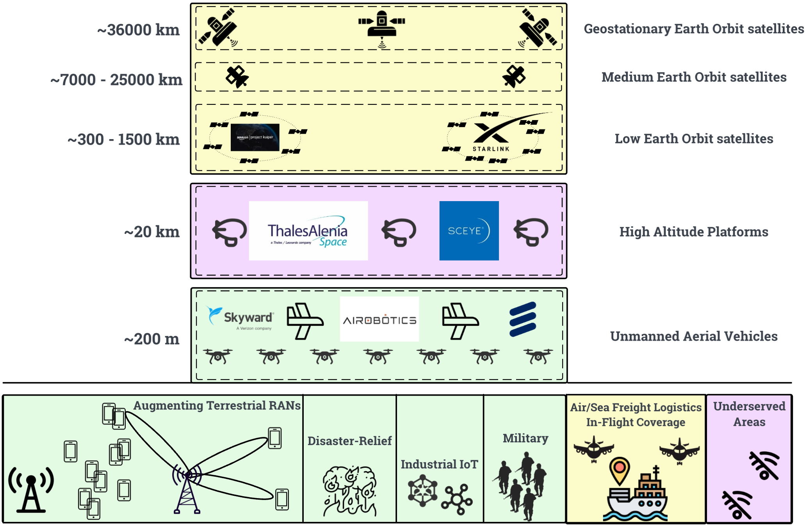
Visualizing the vertical integration of Non-Terrestrial Networks

Slide 5
Motivation: Applications I (Satellites & HAPs)
Thales-Alenia Stratobus Platform (French/EU military communications) [HAP]
Sceye (Navajo Nation universal broadband access, mMIMO A2G Open RAN) [HAP]
SpaceX Starlink Consumer services (isolated areas, war/disaster affected regions) [LEOs]
SpaceX Starlink Business services (Delta in-flight broadband, air/sea freight connectivity) [LEOs]
Softbank Skylo Narrowband IoT connectivity services (commercial fishing, freight logistics) [GEOs]
We will focus on the UAV layer.
We will first study commercial R&D in the space and then outline our research.

Slide 6
Motivation: Applications II (UAVs)
3D Mobility & Maneuverability of UAVs can be leveraged in:
Public-Safety
Disaster-Relief
Precision Agriculture
Military Deployments
URLLC QoS guarantees in Industrial IoT

Slide 7
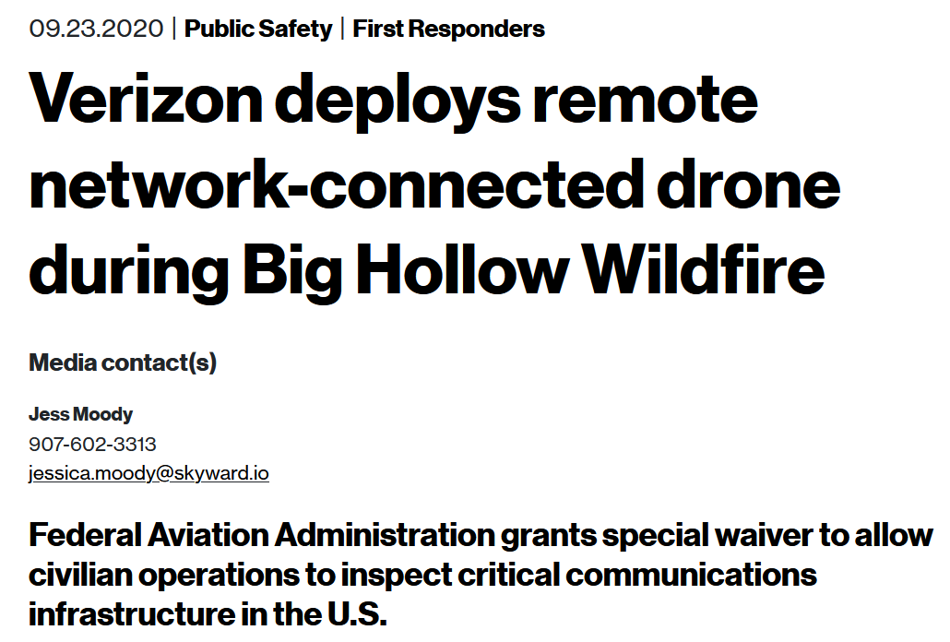
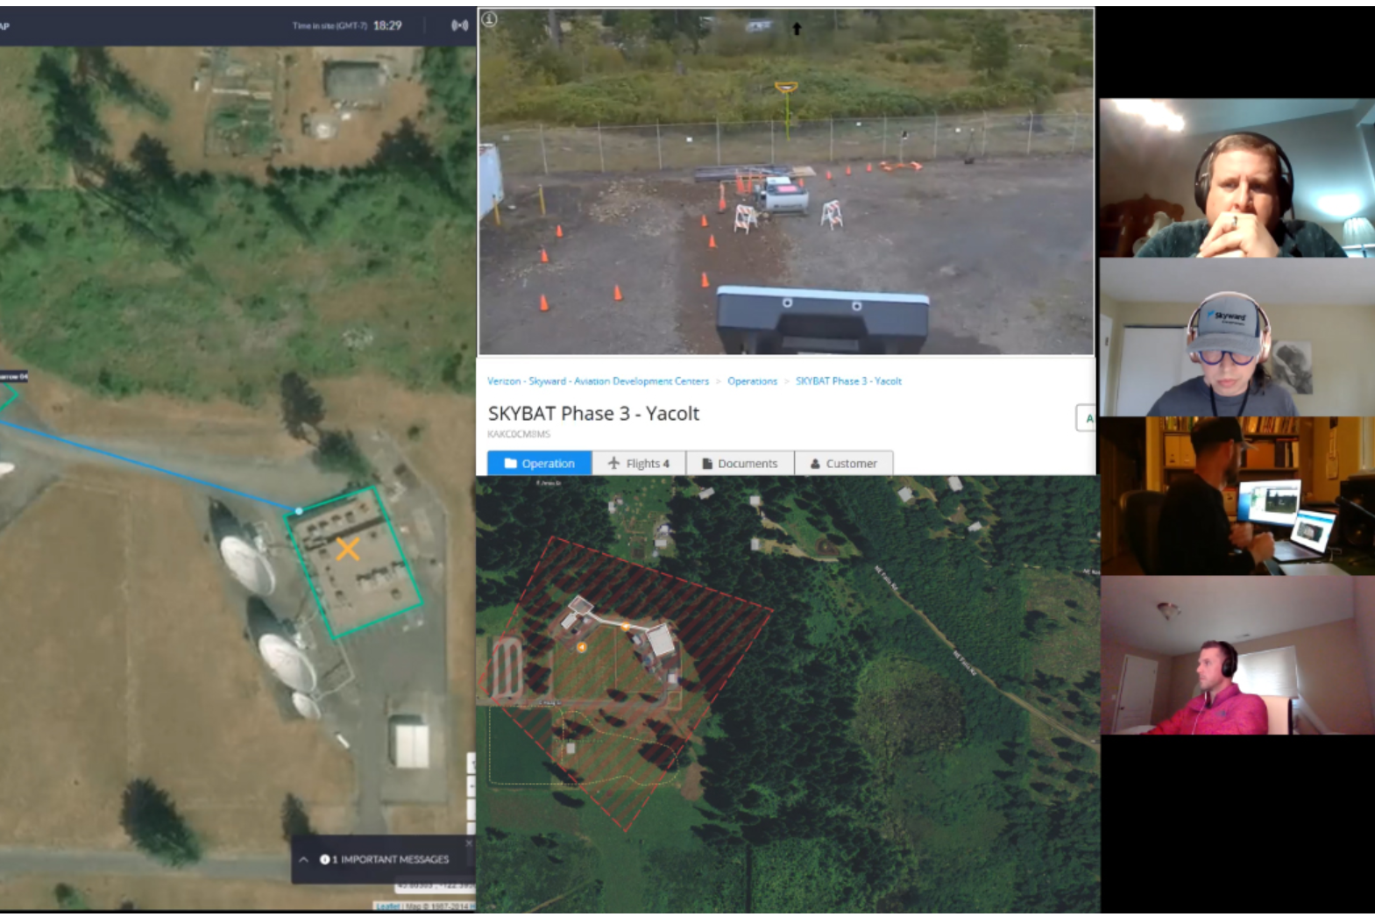
UAVs in Disaster-Relief
Verizon-Skyward LTE-enabled UAV-management platform monitoring infrastructure during the Big Hollow fire in WA

Slide 8

5G-enabled Drone Surveillance
Verizon 5G use-case for monitoring public-safety risks via connected autonomous drones

Slide 9
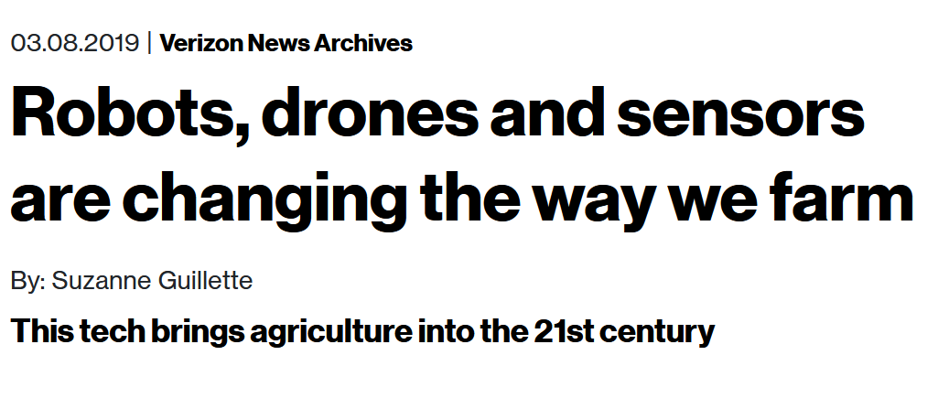
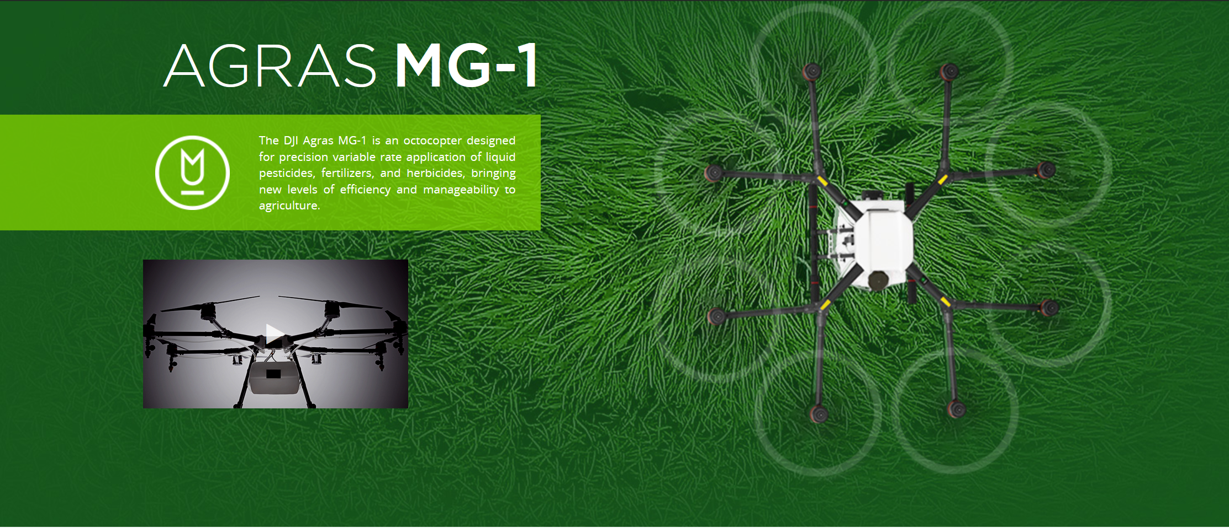
UAVs in Precision Agriculture
Verizon-Skyward precision agriculture use-cases:
Automating DJI AGRAS MG-1 UAVs
Data Harvesting or Coverage Extension* for
VIGOR soil sensors
MooCall livestock monitors
AgOpenGPS seeding workflows
Autonomous harvesters
Ecorobotix weeding
*Especially crucial for Millimeter Wave Communications
Keshavamurthy, B., Zhang, Y., et al. (2021). A Robotic Antenna Alignment and Tracking System for Millimeter Wave Propagation Modeling. arXiv, abs/2110.07106.

Slide 10

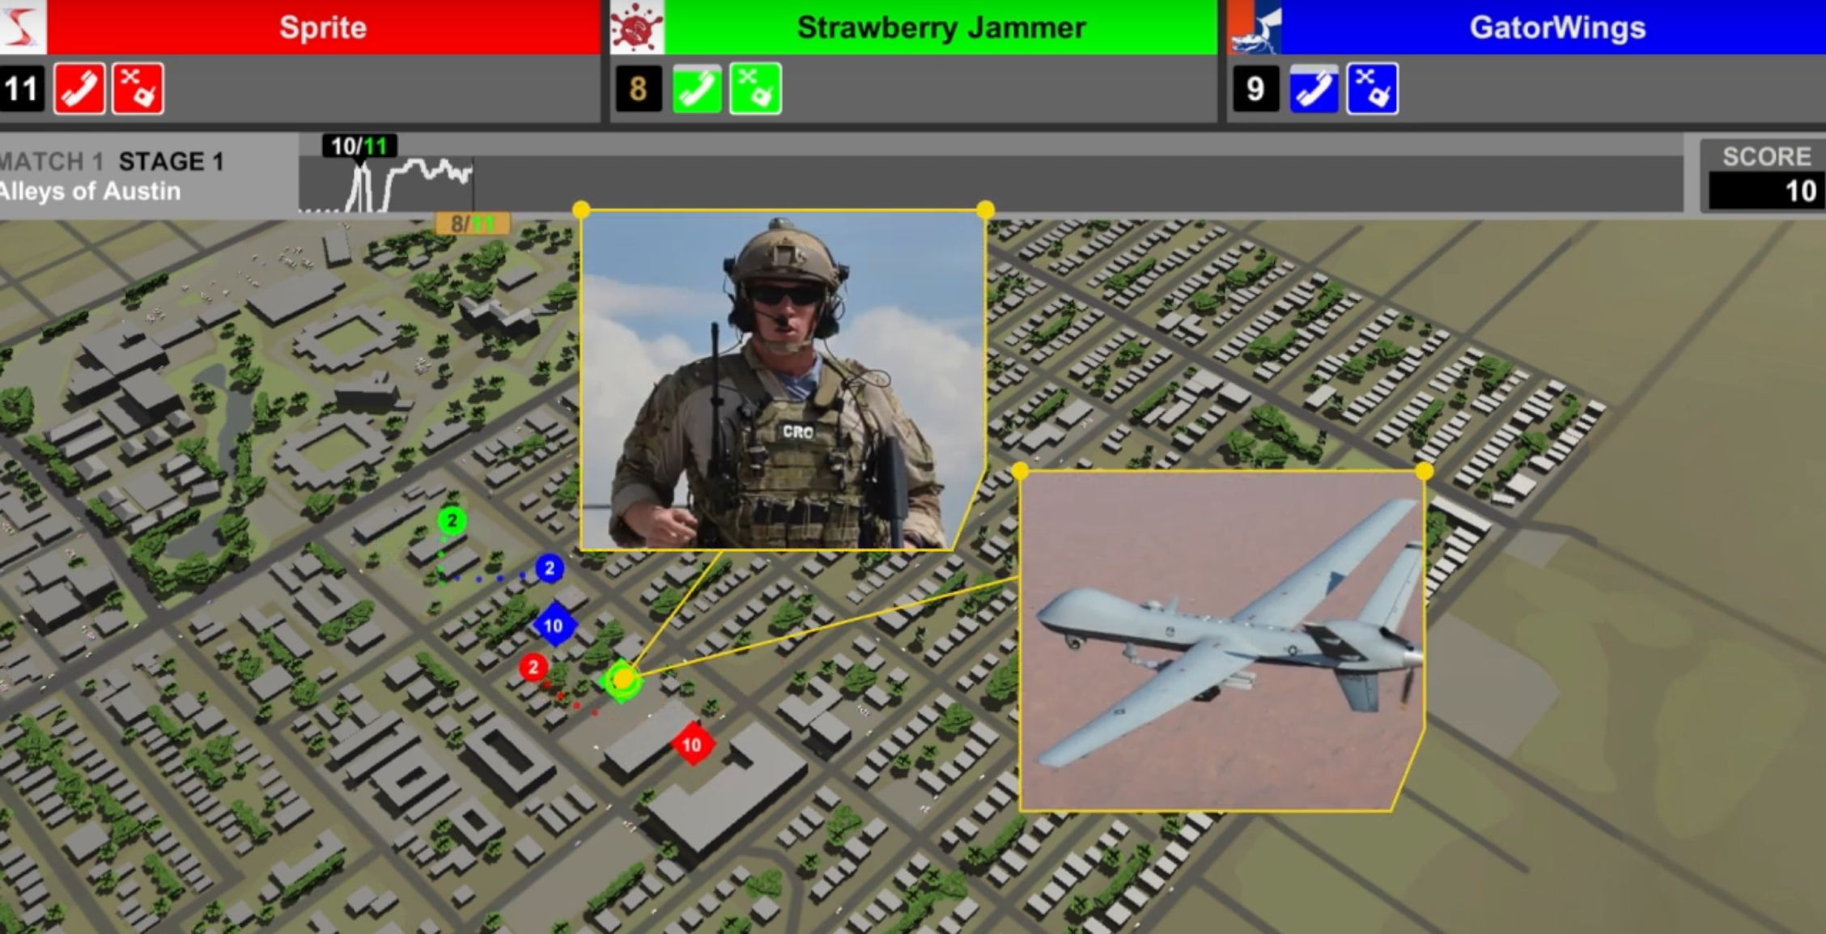
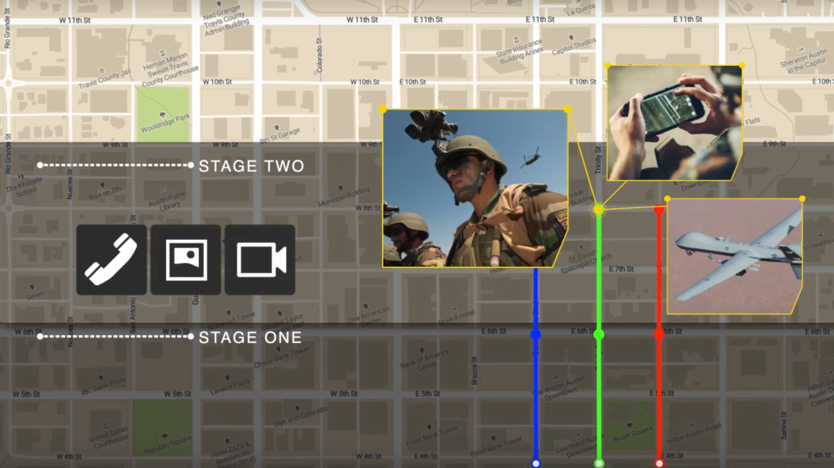
UAVs in Military Deployments: DARPA SC2
B. Keshavamurthy and N. Michelusi, "Learning-based Spectrum Sensing and Access in Cognitive Radios via Approximate POMDPs," in IEEE Transactions on Cognitive Communications and Networking, doi: 10.1109/TCCN.2021.3129802.

Slide 11



UAVs for URLLC QoS
Case Study: Industrial Automation
Ultra-Reliable Low-Latency Communication
Heterogeneous sets of sensors and actuators
Achieving Industrial Automation via 5G (Ericsson + Audi)
Monitoring process-critical parameters (Airobotics)

Slide 12
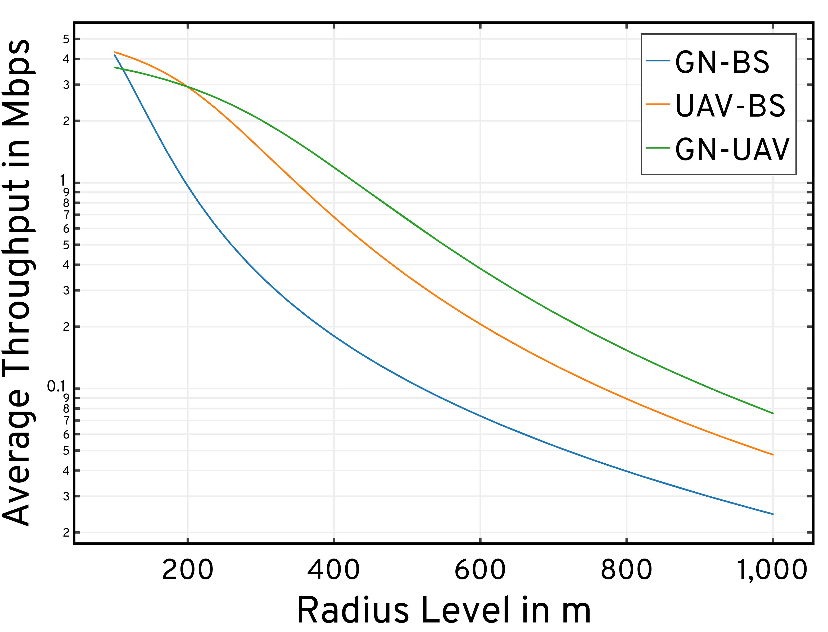
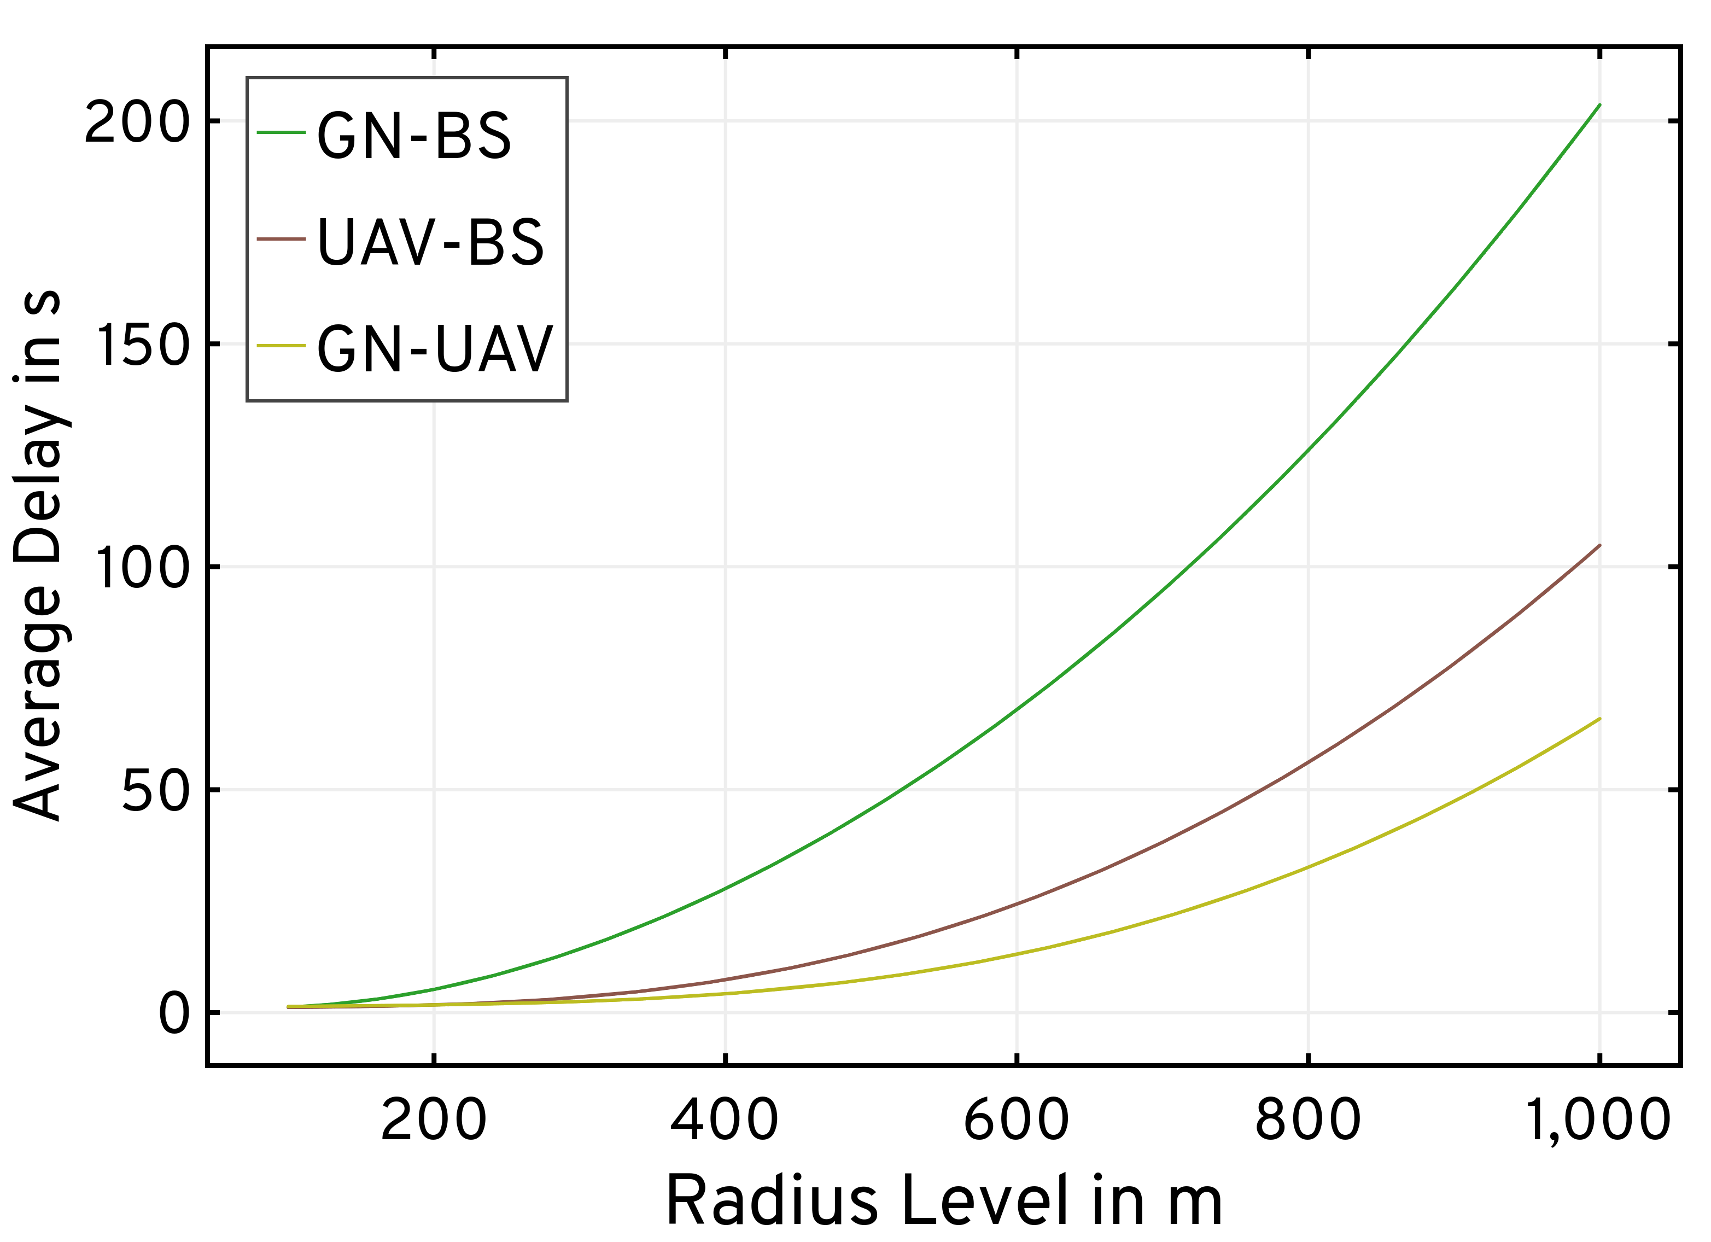
Motivation: A2G Channel Model | GN-BS Service Delays

Slide 13
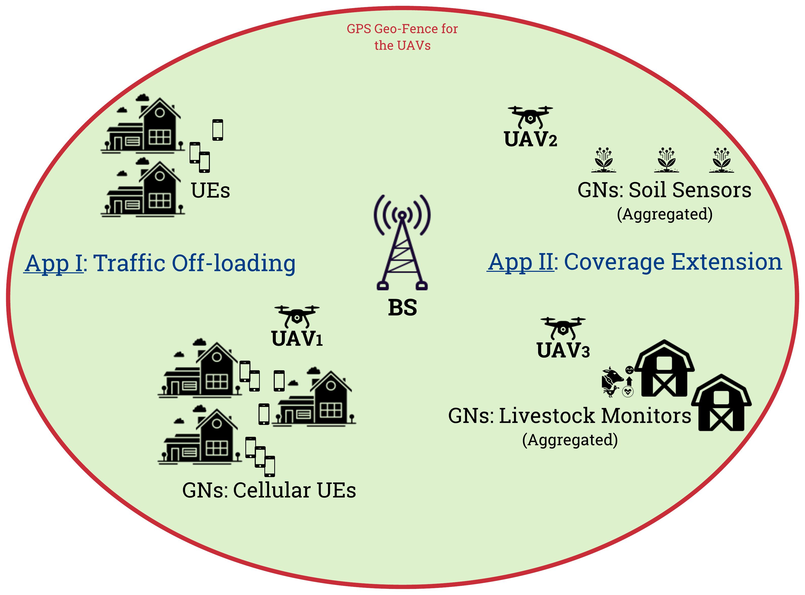
Problem Statement
Control: Dynamic traffic from Ground Nodes (GNs)
Channel Model: Air-to-Ground (A2G) Channel Stochastics
Formulation: Computational feasibility | Trajectory design
Multi-Agent: Distributed coordination | Command & Control
Objective: Optimizing QoS mandates versus on-board UAV energy constraints
Deployment: Orchestrating a swarm of UAVs serving as cellular relays for augmenting a terrestrial Base Station (BS) via traffic offloading and coverage extension

Slide 14
State-of-the-art: Approaches & Drawbacks
Control [1, 2, 3, 4]:
Non-adaptive
Deterministic traffic models
Unreasonable assumptions on GN capabilities
Approaches rely on Successive Convex Approximation (SCA):
Tackles non-convex problems with iterative optimization involving convex approximations at a local point
Involves prohibitively large policy convergence times
Precludes the incorporation of dynamic traffic models
Channel Model [1,2,3,4]:
Inaccurately employ free space pathloss models
Fail to exploit the A2G channel characteristics
SCA: Approximations in data payload delivery constraints to enforce convexity
[1] Y. Zeng et al., “Energy Minimization for Wireless Communication With Rotary-Wing UAV,” IEEE Transactions on Wireless Communications, vol. 18, no. 4, pp. 2329–2345, April 2019.
[2] M. A. Abd-Elmagid and H. S. Dhillon, “Average Peak Age-of-Information Minimization in UAV-Assisted IoT Networks,” IEEE Transactions on Vehicular Technology, vol. 68, no. 2, pp. 2003–2008, 2019.
[3[ X. Hu et al., “UAV-Assisted Relaying and Edge Computing: Scheduling and Trajectory Optimization,” IEEE Transactions on Wireless Communications, vol. 18, no. 10, pp. 4738–4752, 2019
[4] C. You and R. Zhang, “3D Trajectory Optimization in Rician Fading for UAV-Enabled Data Harvesting,” IEEE Transactions on Wireless Communications, vol. 18, no. 6, pp. 3192–3207, 2019

Slide 15
State-of-the-art: Approaches & Drawbacks
UAV Trajectory Design:
Static positioning [1,2,3]
SCA [4]: Approximations in mobility model constraints to enforce convexity
Restricted Mobility: Fixed forward flying velocity [4] | Impractical path structures [3]
Particle Swarm Optimization (PSO) [1,2,3] is inefficient (limited update scope) and computationally intractable
UAV Deployment:
Single UAV deployments are insufficient [1,2,3,4]
Centralized swarm control suffers from higher OPEX and CAPEX [5,6]
Joint multi-UAV constructions [7,8] lead to prohibitively large solution spaces
[1] H. Shakhatreh et al., “Efficient 3D placement of a UAV using particle swarm optimization,” in 2017 8th International Conference on Information and Communication Systems (ICICS), 2017, pp. 258–263.
[2] Z. Yuheng et al., “3-D Deployment Optimization of UAVs Based on Particle Swarm Algorithm,” in 2019 IEEE 19th International Conference on Communication Technology (ICCT), 2019, pp. 954–957.
[3] R. K. Patra, P. Muthuchidambaranathan, “Optimisation of Spectrum and Energy Efficiency in UAV-Enabled Mobile Relaying Using Bisection and PSO Method,” in 2018 International Conference for Convergence in Technology (I2CT), 2018, pp. 1–7.
[4] M. A. Abd-Elmagid and H. S. Dhillon, “Average Peak Age-of-Information Minimization in UAV-Assisted IoT Networks,” IEEE Transactions on Vehicular Technology, vol. 68, no. 2, pp. 2003–2008, 2019.
[5] Q. Wu et al., “Joint Trajectory and Communication Design for Multi-UAV Enabled Wireless Networks,” IEEE Transactions on Wireless Communications, vol. 17, no. 3, pp. 2109–2121, 2018.
[6] M. Mozaffari et al., “Efficient Deployment of Multiple Unmanned Aerial Vehicles for Optimal Wireless Coverage,” IEEE Communications Letters, vol. 20, no. 8, pp. 1647–1650, 2016.
[7] Q. Hu et al., “Low-Complexity Joint Resource Allocation and Trajectory Design for UAV-Aided Relay Networks With the Segmented Ray-Tracing Channel Model,” IEEE Transactions on Wireless Communications, vol. 19, no. 9, pp. 6179–6195, 2020.
[8] A. E. A. A. Abdulla et al., “Toward Fair Maximization of Energy Efficiency in Multiple UAS-Aided Networks: A Game-Theoretic Methodology,” IEEE Transactions on Wireless Communications, vol. 14, no. 1, pp. 305–316, Jan 2015.

Slide 16
State-of-the-art: Approaches & Drawbacks
Overall Formulation [1,2]:
Model-free frameworks
Combined state- and action-spaces
Fail to effectively capture the problem structure
Typically resulting in large policy convergence times
Link Layer Studies:
Approaches forgo queuing analyses
Those that do consider queueing dynamics, do so only at the GNs [3]
[1] H. Bayerlein et al., “Multi-UAV Path Planning for Wireless Data Harvesting With Deep Reinforcement Learning,” IEEE Open Journal of the Communications Society, vol. 2, p. 1171–1187, 2021.
[2] L. Wang et al., “Multi-Agent Deep Reinforcement Learning-Based Trajectory Planning for Multi-UAV Assisted Mobile Edge Computing,” IEEE Transactions on Cognitive Communications and Networking, vol. 7, no. 1, pp. 73–84, 2021.
[3] A. M. Koushik et al., “Deep Q -Learning-Based Node Positioning for Throughput-Optimal Communications in Dynamic UAV Swarm Network,” IEEE Transactions on Cognitive Communications and Networking, vol. 5, no. 3, pp. 554–566, 2019.

Slide 17
Our Contributions: Objective
Minimize the time-average service delay subject to an average UAV power constraint:
Optimize UAV operations in both waiting and communication service phases
Our problem exhibits a multiscale structure: Waiting & Communication states | Two-layer decision-making
Multiscale Adaptive Energy-conscious Scheduling and TRajectory Optimization (MAESTRO)

Slide 18
Our Contributions: Addressing the challenges
Adaptive Control:
UAVs relay dynamically-generated traffic from miscellaneous sets of randomly distributed GNs
Non-SCA approach allows for a control framework that is adaptive to uncertain system dynamics
A Semi-Markov Decision Process (SMDP) formulation captures temporal irregularities in state transitions
A2G Channel Model:
Accurately model A2G channel characteristics along BS-UAV and GN-UAV links
Incorporation of rate-adaptation at all transmitters to maximize system throughput
Our SMDP formulation mitigates approximations in the data payload delivery constraints

Slide 19
Our Contributions: Addressing the challenges
UAV Trajectory Design:
Hierarchical Competitive Swarm Optimization (HCSO)
Unlike SCA, CSO does not rely on a specific problem structure
Unlike PSO, CSO has more efficient updates via pair-wise competition
Distributed Swarm Deployments:
Decoupled executions via policy replication across the swarm
Overlay a fully-connected mesh network for command & control
Multi-UAV heuristics for spread maximization and conflict resolution
M/G/x queuing models incorporated at both the BS as well as the UAVs
QoS studies include queue wait times and queue management heuristics

Slide 20
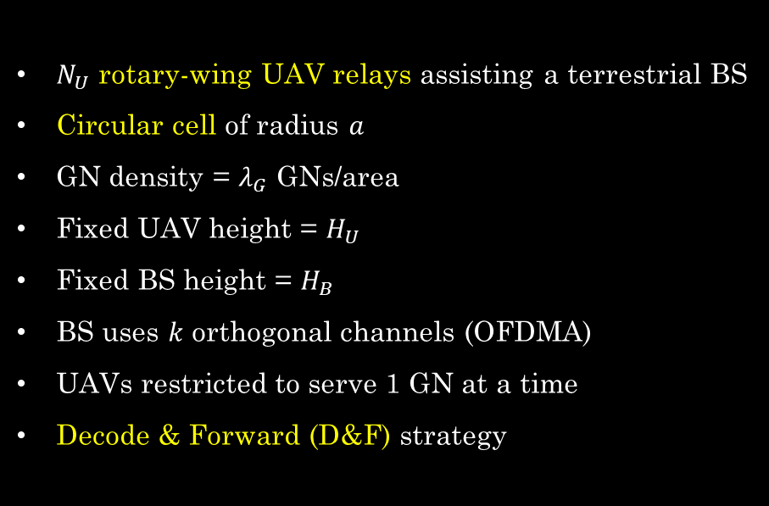
System Model: Deployment
$N_{U}$ rotary-wing UAV relays assisting a terrestrial BS
Circular cell of radius $a$
GN density = $λ_{G}$ GNs/area
Fixed UAV height = $H_{U}$
Fixed BS height = $H_{B}$
BS uses $k$ orthogonal channels (OFDMA)
UAVs restricted to serve 1 GN at a time
Decode & Forward (D&F) strategy
A sample deployment in precision agriculture/mechanized farming (Not to scale)

Slide 21
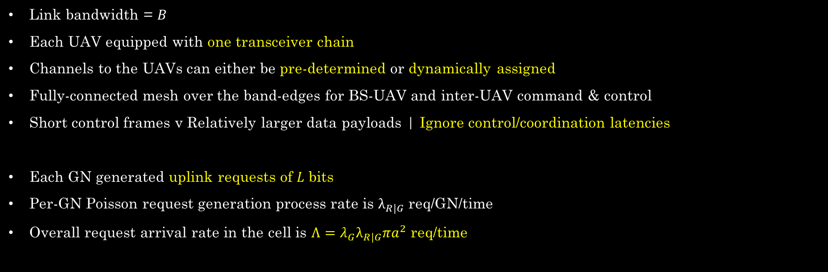
System Model: Communication
Link bandwidth = $B$
Each UAV equipped with one transceiver chain
Channels to the UAVs can either be pre-determined or dynamically assigned
Fully-connected mesh over the band-edges for BS-UAV and inter-UAV command & control
Short control frames v Relatively larger data payloads | Ignore control/coordination latencies
Each GN generated uplink requests of $L$ bits
Per-GN Poisson request generation process rate is $λ_{R|G}$ req/GN/time
Overall request arrival rate in the cell is $Λ=λ_{G}λ_{R|G}πa^{2}$ req/time

Slide 22
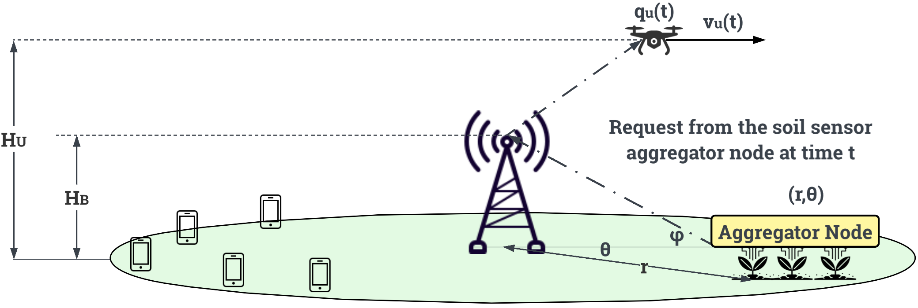
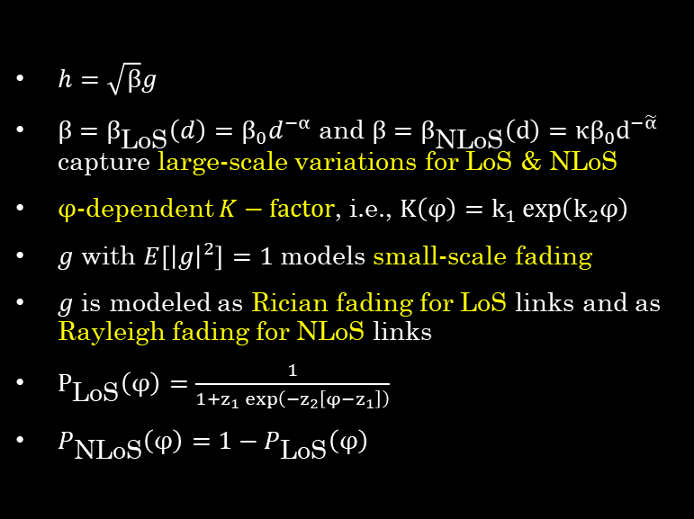
System Model: Channel
$h=\sqrt{β}g$
$β=β_{\text{LoS}}\left(d\right)=β_{0}d^{−α}$ and $β=β_{\text{NLoS}}\left(d\right)=κβ_{0}d^{−\tilde{α}}$ capture large-scale variations for LoS & NLoS
$φ$-dependent $K−factor$, i.e., $K\left(φ\right)=k_{1}\exp\left(k_{2}φ\right)$
$g$ with $E\left[{\left|g\right|}^{2}\right]=1$ models small-scale fading
$g$ is modeled as Rician fading for LoS links and as Rayleigh fading for NLoS links
$P_{\text{LoS}}\left(φ\right)=\frac{1}{1+z_{1}\exp\left(−z_{2}\left[φ−z_{1}\right]\right)}$
$P_{\text{NLoS}}\left(φ\right)=1−P_{\text{LoS}}\left(φ\right)$
[1] C. You and R. Zhang, “3D Trajectory Optimization in Rician Fading for UAV-Enabled Data Harvesting,” IEEE Transactions on Wireless Communications, vol. 18, no. 6, pp. 3192–3207, 2019.
[2] A. Al-Hourani, S. Kandeepan, and S. Lardner, “Optimal LAP Altitude for Maximum Coverage,” IEEE Wireless Communications Letters, vol. 3, no. 6, pp. 569–572, 2014.
[3] D. Tse and P. Viswanath, Fundamentals of Wireless Communication. Cambridge: Cambridge University Press, 2005.
[4] R. Essaadali and A. Kouki, “A new simple Unmanned Aerial Vehicle doppler effect RF reducing technique,” in MILCOM 2016 - 2016 IEEE Military Communications Conference, 2016, pp. 1179–1183.

Slide 23
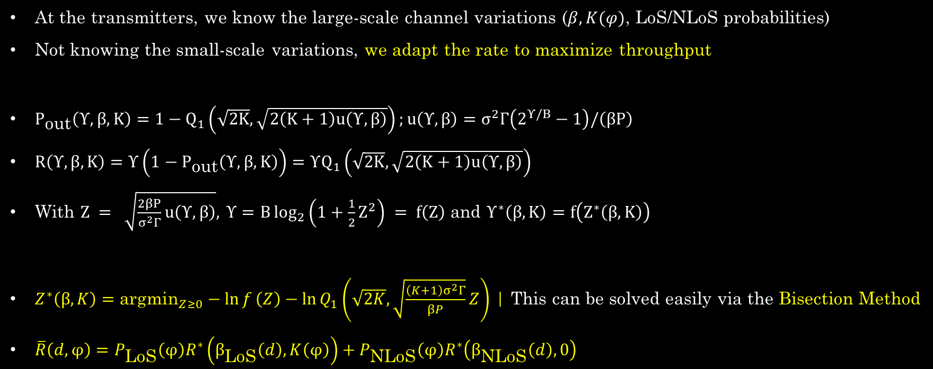
System Model: Channel | Rate Adaptation
At the transmitters, we know the large-scale channel variations ($β, K(φ)$, LoS/NLoS probabilities)
Not knowing the small-scale variations, we adapt the rate to maximize throughput
$P_{\text{out}}\left(Υ,β,K\right)=1−Q_{1}\left(\sqrt{2K},\sqrt{2\left(K+1\right)u\left(Υ,β\right)}\right);u\left(Υ,β\right)=σ^{2}Γ\left(2^{Υ/B}−1\right)/\left(βP\right)$
$R\left(Υ,β,K\right)=Υ\left(1−P_{\text{out}}\left(Υ,β,K\right)\right)=ΥQ_{1}\left(\sqrt{2K},\sqrt{2\left(K+1\right)u\left(Υ,β\right)}\right)$
With $Z = \sqrt{\frac{2βP}{σ^{2}Γ}u\left(Υ,β\right)}, Υ=B\log_{2}\left(1+\frac{1}{2}Z^{2}\right) = f\left(Z\right) \text{and} Υ^{∗}\left(β,K\right)=f\left(Z^{∗}\left(β,K\right)\right)$
$Z^{∗}\left(β,K\right)={\text{argmin}}_{Z≥0}−\ln{f}\left(Z\right)−\ln{Q_{1}}\left(\sqrt{2K},\sqrt{\frac{\left(K+1\right)σ^{2}Γ}{βP}}Z\right)$ | This can be solved easily via the Bisection Method
$\overline{R}\left(d,φ\right)=P_{\text{LoS}}\left(φ\right)R^{∗}\left(β_{\text{LoS}}\left(d\right),K\left(φ\right)\right)+P_{\text{NLoS}}\left(φ\right)R^{∗}\left(β_{\text{NLoS}}\left(d\right),0\right)$

Slide 24
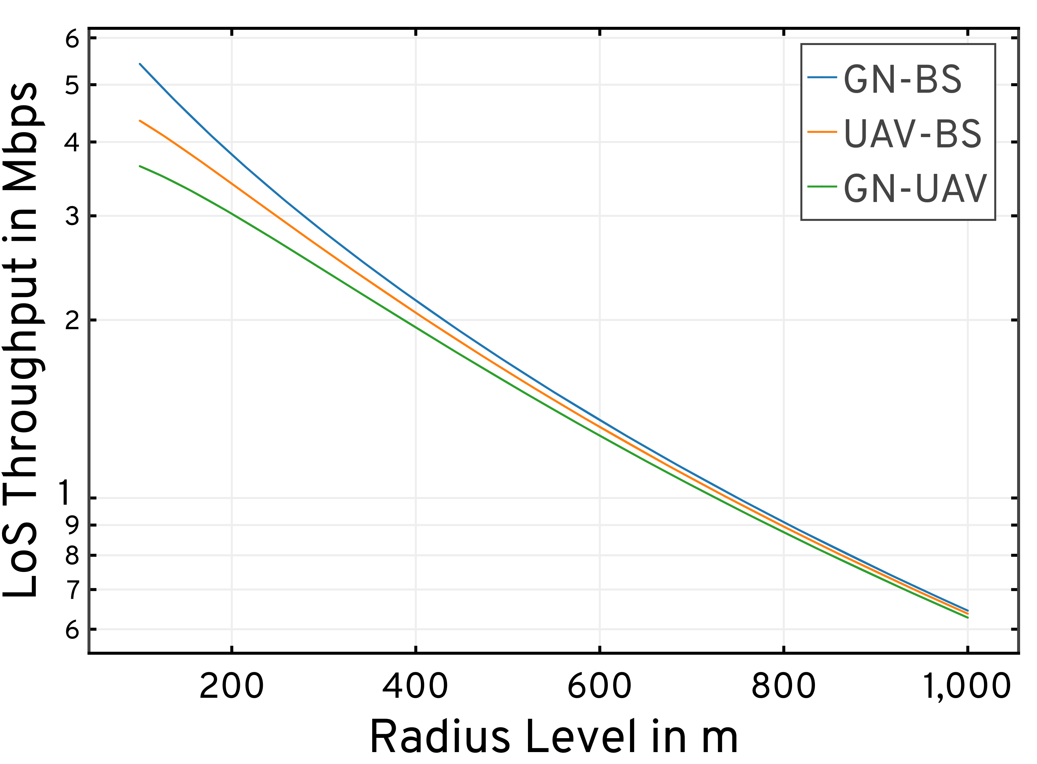
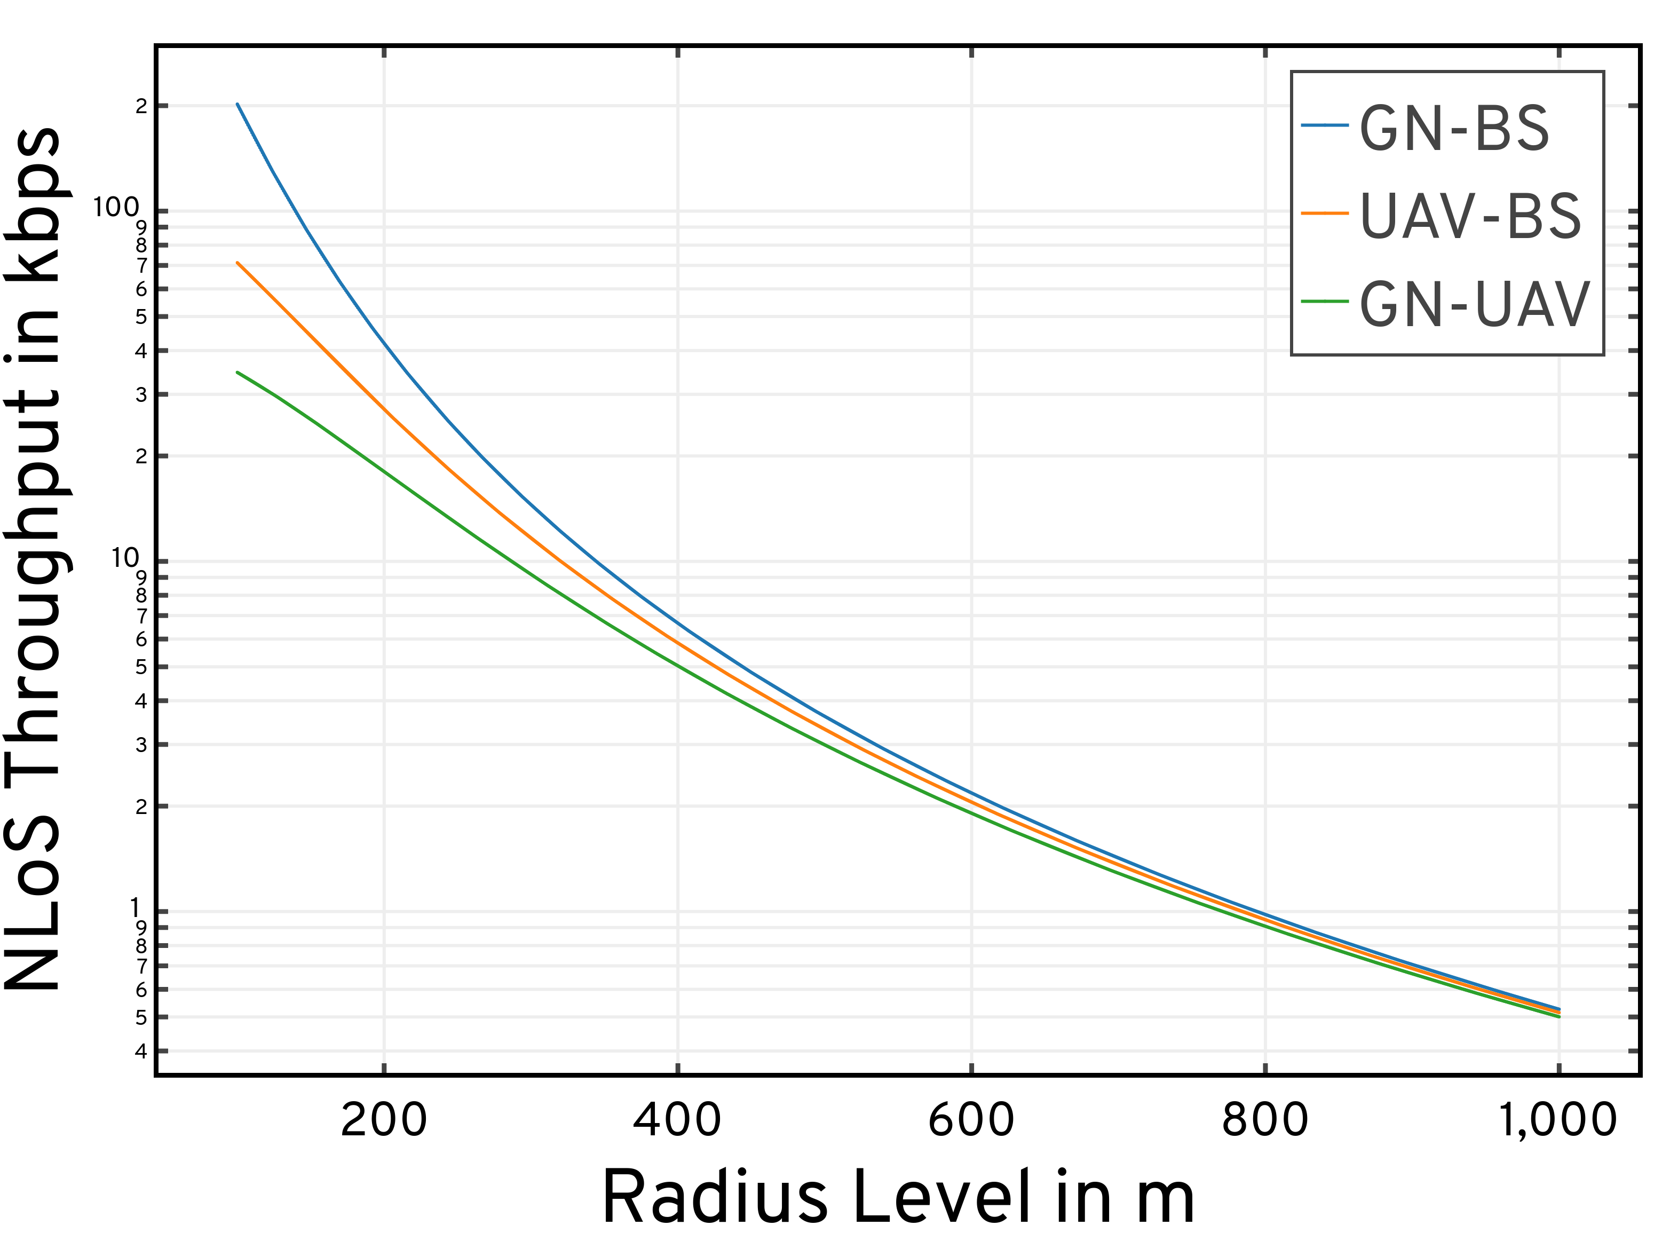
Performance: A2G Channel Model with Rate Adaptation

Slide 25
Performance: A2G Channel Model with Rate Adaptation

Slide 26
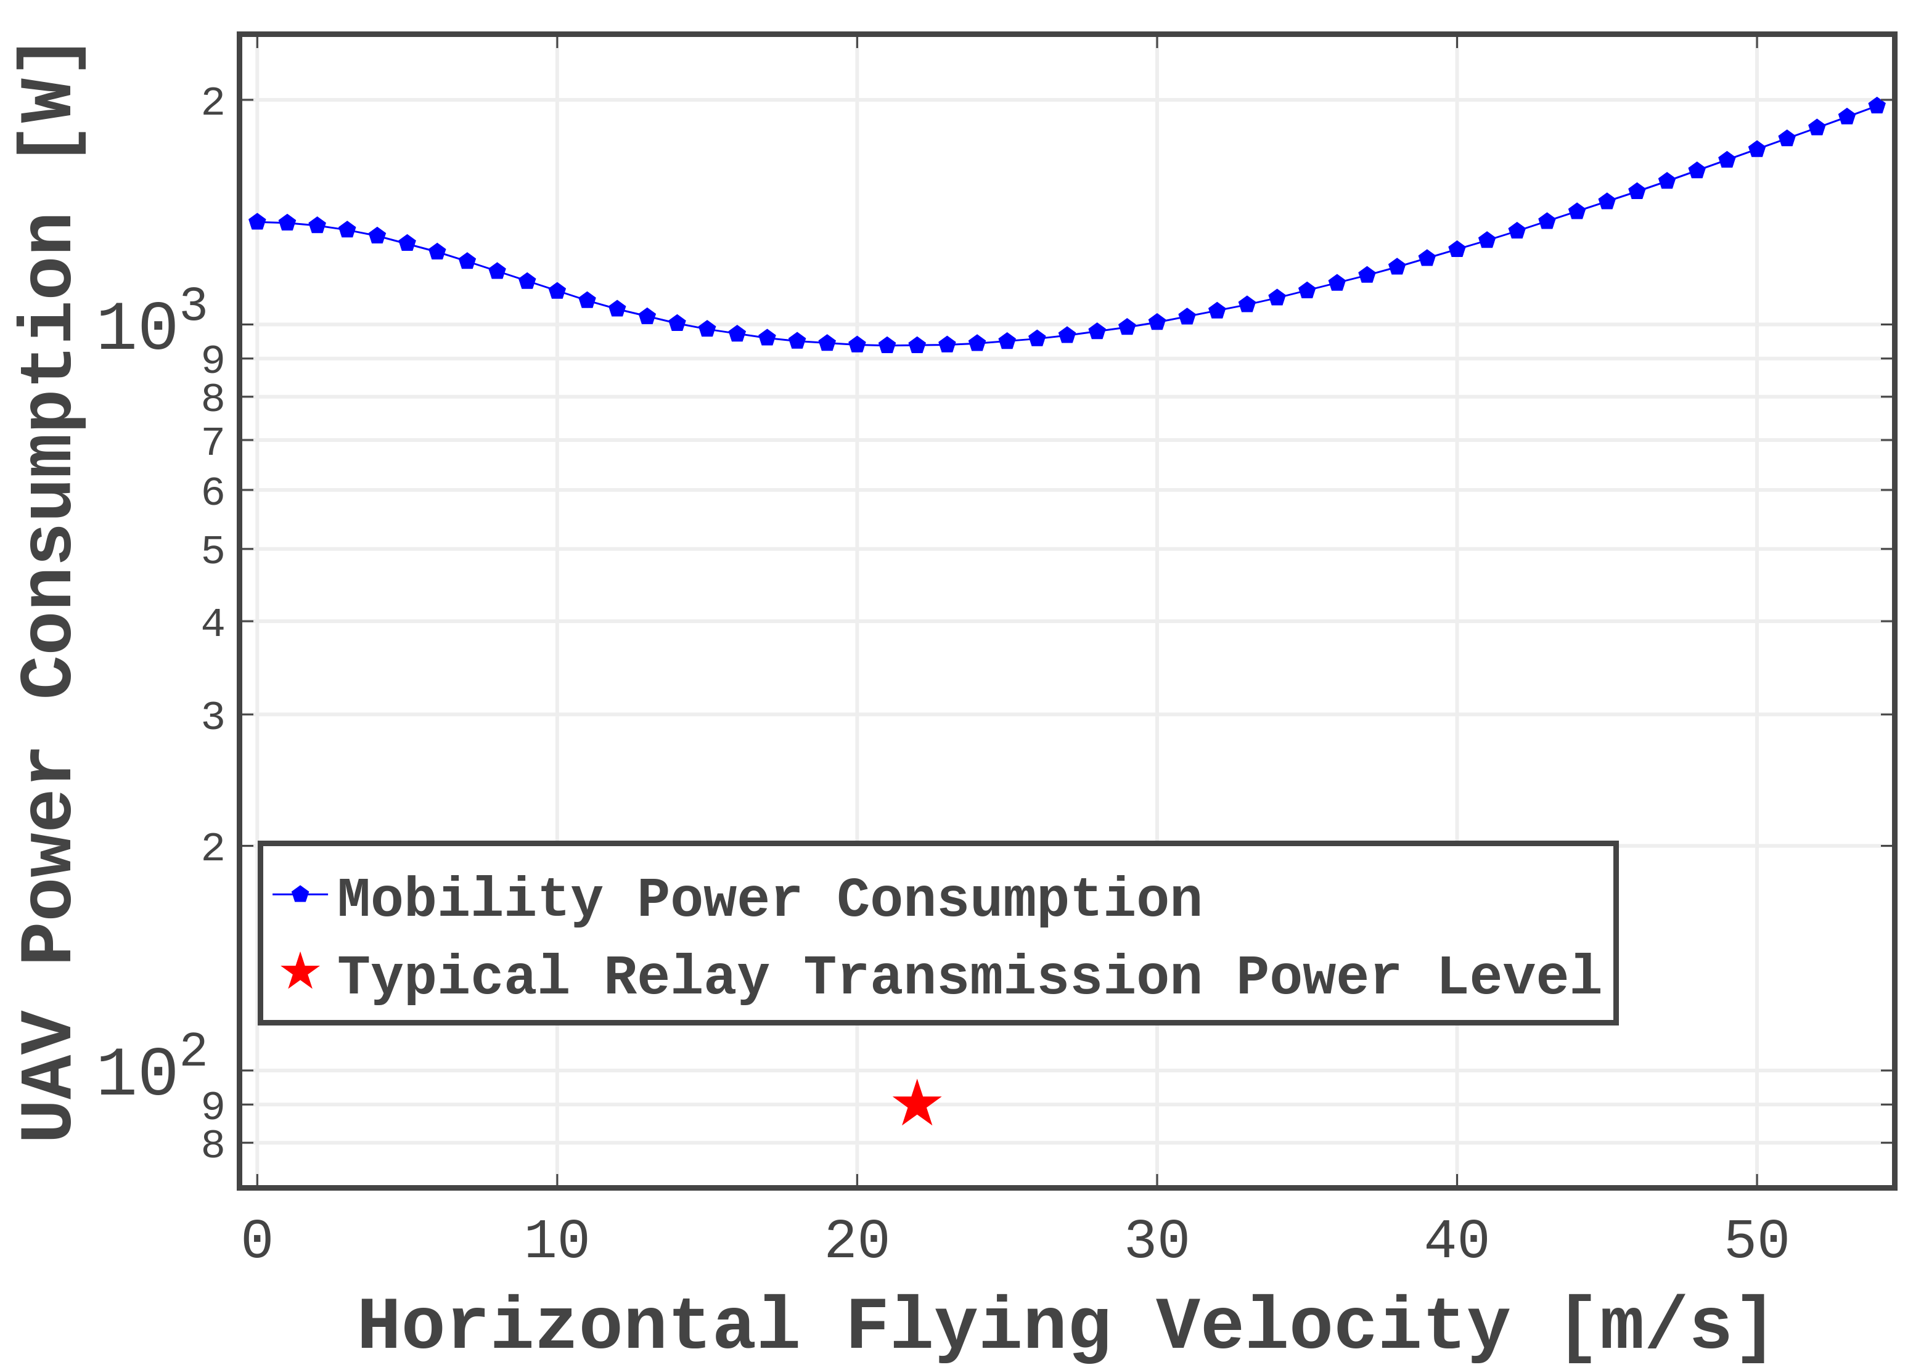
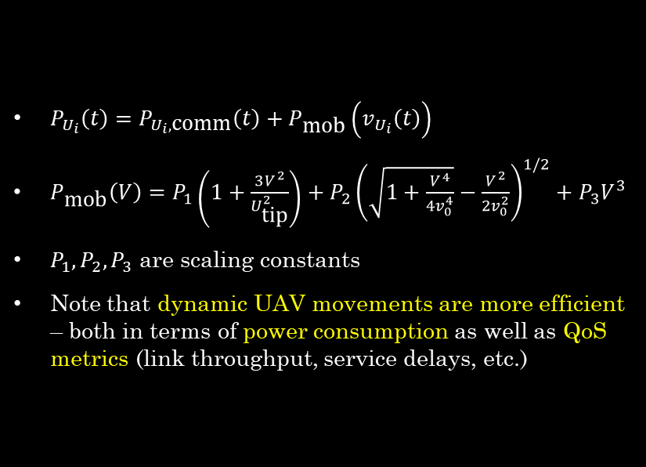
System Model: Power
$P_{U_{i}}\left(t\right)=P_{U_{i},\text{comm}}\left(t\right)+P_{\text{mob}}\left(v_{U_{i}}\left(t\right)\right)$
$P_{\text{mob}}\left(V\right)=P_{1}\left(1+\frac{3V^{2}}{U_{\text{tip}}^{2}}\right)+P_{2}{\left(\sqrt{1+\frac{V^{4}}{4v_{0}^{4}}}−\frac{V^{2}}{2v_{0}^{2}}\right)}^{1/2}+P_{3}V^{3}$
$P_{1},P_{2},P_{3}$ are scaling constants
Note that dynamic UAV movements are more efficient – both in terms of power consumption as well as QoS metrics (link throughput, service delays, etc.)
[1] Y. Zeng et al., “Energy Minimization for Wireless Communication With Rotary-Wing UAV,” IEEE Transactions on Wireless Communications, vol. 18, no. 4, pp. 2329–2345, April 2019.

Slide 27
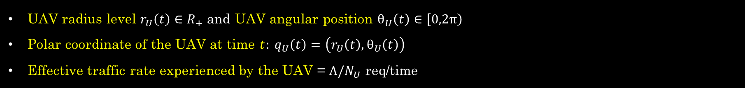
MAESTRO: Single-Agent Specialization
UAV radius level $r_{U}\left(t\right)∈R_{+}$ and UAV angular position $θ_{U}\left(t\right)∈\left[0,2π\right)$
Polar coordinate of the UAV at time $t: q_{U}\left(t\right)=\left(r_{U}\left(t\right),θ_{U}\left(t\right)\right)$
Effective traffic rate experienced by the UAV = $Λ/N_{U}$ req/time

Slide 28
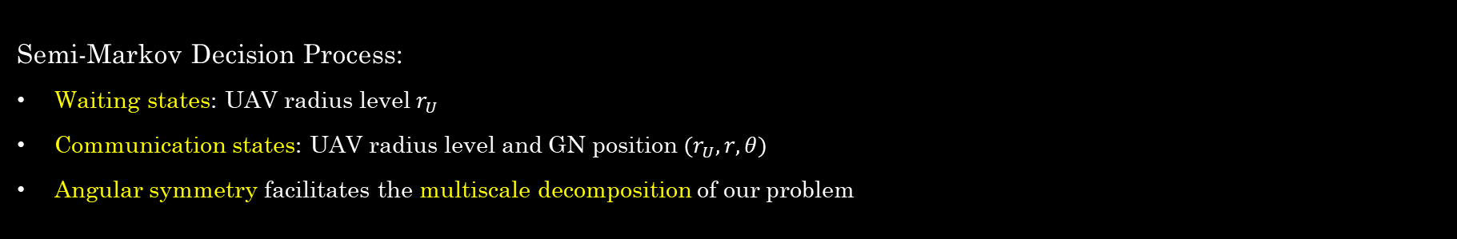
MAESTRO: SMDP Formulation
Semi-Markov Decision Process:
Waiting states: UAV radius level $r_{U}$
Communication states: UAV radius level and GN position $(r_{U}, r, θ)$
Angular symmetry facilitates the multiscale decomposition of our problem

Slide 29
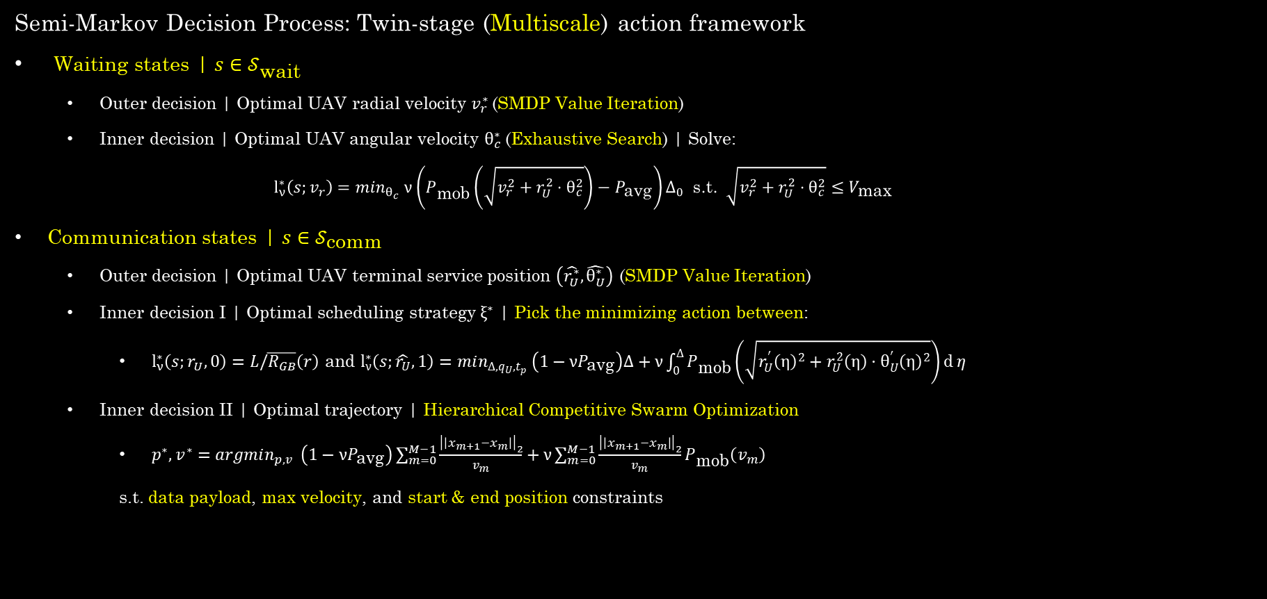
MAESTRO: SMDP Formulation
Semi-Markov Decision Process: Twin-stage (Multiscale) action framework
Waiting states | $s∈𝒮_{\text{wait}}$
Outer decision | Optimal UAV radial velocity $v_{r}^{∗}$(SMDP Value Iteration)
Inner decision | Optimal UAV angular velocity $θ_{c}^{∗}$(Exhaustive Search) | Solve:
$$l_{ν}^{∗}\left(s;v_{r}\right)=\min_{θ_{c}} ν\left(P_{\text{mob}}\left(\sqrt{v_{r}^{2}+r_{U}^{2}⋅θ_{c}^{2}}\right)−P_{\text{avg}}\right)Δ_{0} \text{s}\text{.}\text{t}\text{.} \sqrt{v_{r}^{2}+r_{U}^{2}⋅θ_{c}^{2}}≤V_{\text{max}}$$
Communication states | $s∈𝒮_{\text{comm}}$
Outer decision | Optimal UAV terminal service position $\left(\hat{r_{U}^{∗}},\hat{θ_{U}^{∗}}\right)$ (SMDP Value Iteration)
Inner decision I | Optimal scheduling strategy $ξ^{∗}$ | Pick the minimizing action between:
$l_{ν}^{∗}\left(s;r_{U},0\right)=L/\overline{R_{GB}}\left(r\right)$ and $l_{ν}^{∗}\left(s;\hat{r_{U}},1\right)=min_{Δ,q_{U},t_{p}} \left(1−νP_{\text{avg}}\right)Δ+ν\int_{0}^{Δ}{P_{\text{mob}}\left(\sqrt{r_{U}^{′}{\left(η\right)}^{2}+r_{U}^{2}\left(η\right)⋅θ_{U}^{′}{\left(η\right)}^{2}}\right)\text{d}}η$
Inner decision II | Optimal trajectory | Hierarchical Competitive Swarm Optimization
$p^{∗},v^{∗}=argmin_{p,v} \left(1−νP_{\text{avg}}\right)\sum_{m=0}^{M−1}{\frac{{\left|\left|x_{m+1}−x_{m}\right|\right|}_{2}}{v_{m}}}+ν\sum_{m=0}^{M−1}{\frac{{\left|\left|x_{m+1}−x_{m}\right|\right|}_{2}}{v_{m}}}P_{\text{mob}}\left(v_{m}\right)$
s.t. data payload, max velocity, and start & end position constraints

Slide 30
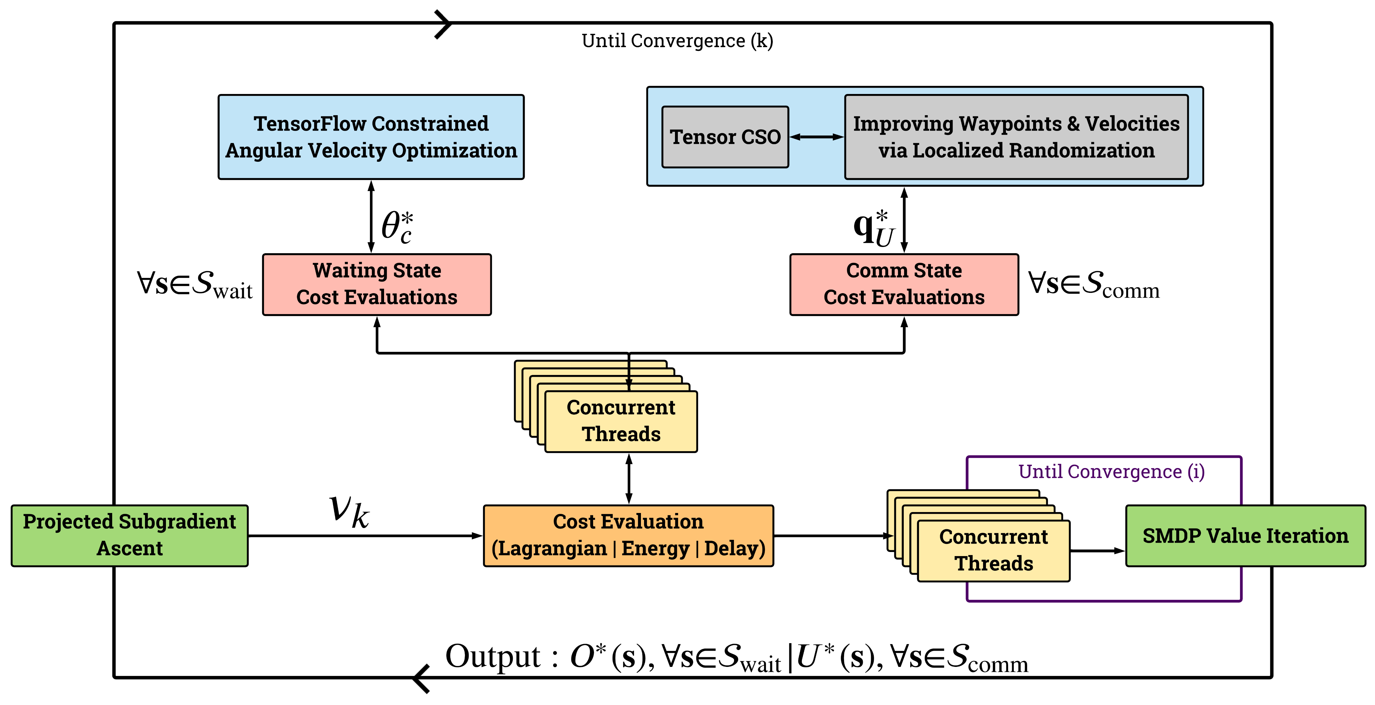
Waiting states: Inner Decision on UAV Angular Velocity
Comm states: Inner Decisions on
UAV Service Trajectory
Waiting states: Outer Decision on UAV Radial Velocity
Comm states: Outer Decisions on
BS/UAV Service & UAV Terminal Position
Algorithmic Flow of the single-agent optimization process

Slide 31
Numerical Evaluations

Slide 32
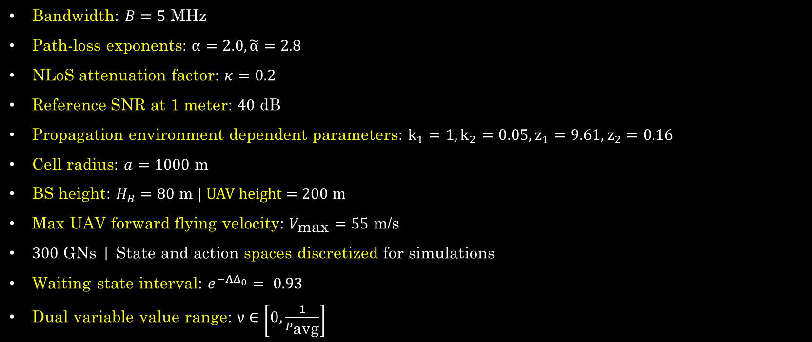
Simulation Setup
Bandwidth: $B=5$ MHz
Path-loss exponents: $α=2.0, \tilde{α}=2.8$
NLoS attenuation factor: $κ=0.2$
Reference SNR at 1 meter: $40$ dB
Propagation environment dependent parameters: $k_{1}=1,k_{2}=0.05,z_{1}=9.61,z_{2}=0.16$
Cell radius: $a=1000 \text{m}$
BS height: $H_{B}=80 \text{m} |$ UAV height = 200 m
Max UAV forward flying velocity: $V_{\text{max}}=55$ m/s
$300$ GNs | State and action spaces discretized for simulations
Waiting state interval: $e^{−ΛΔ_{0}}= 0.93$
Dual variable value range: $ν∈\left[0,\frac{1}{P_{\text{avg}}}\right]$

Slide 33
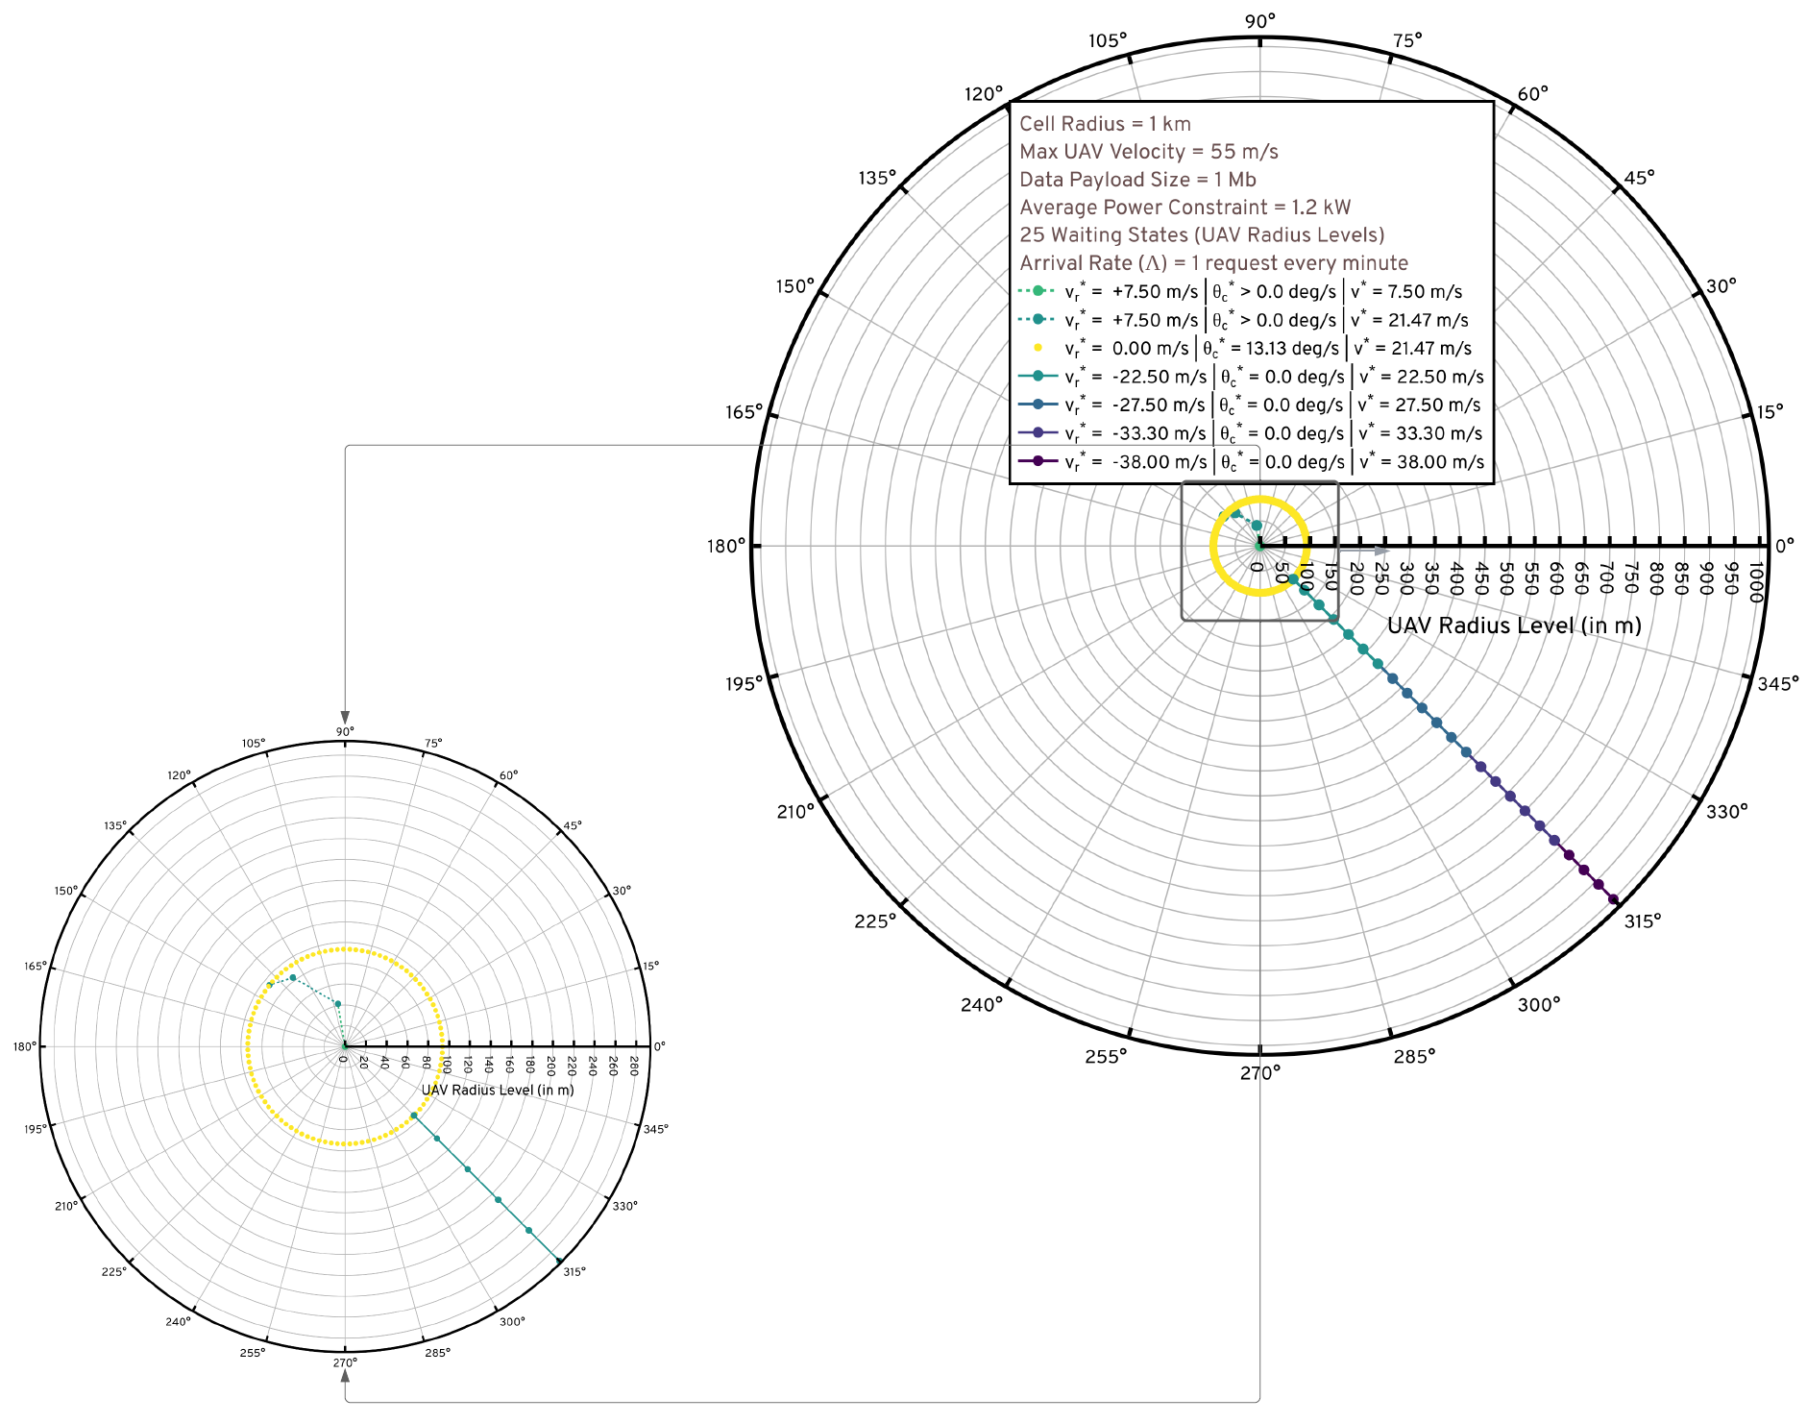
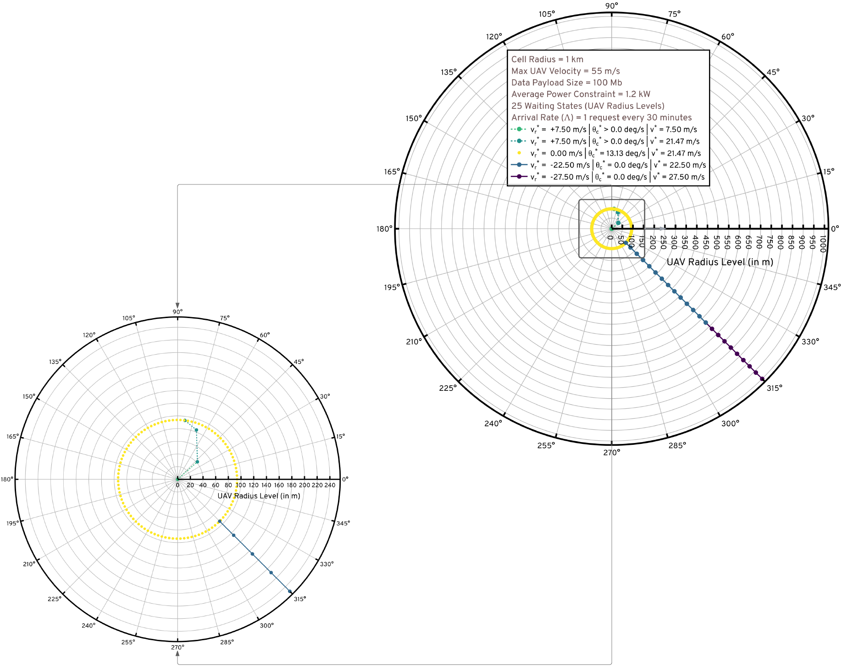
MAESTRO Waiting Policy Visualization: $L=1$ Mb (left) and $L=$100 Mb (right)

Slide 34
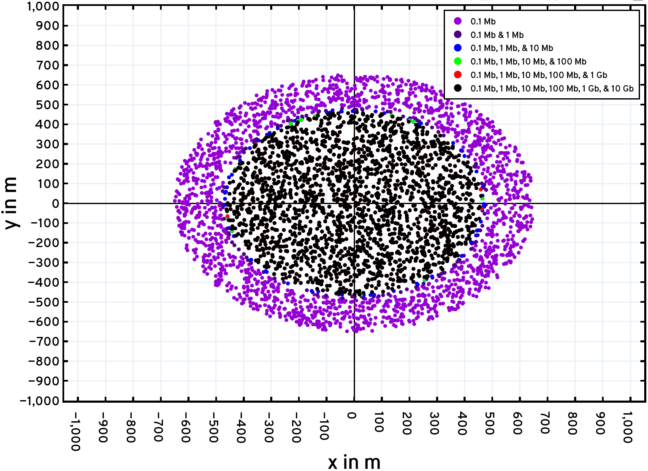
MAESTRO Scheduling Visualization: GNs served by the BS directly for varying $L$

Slide 35
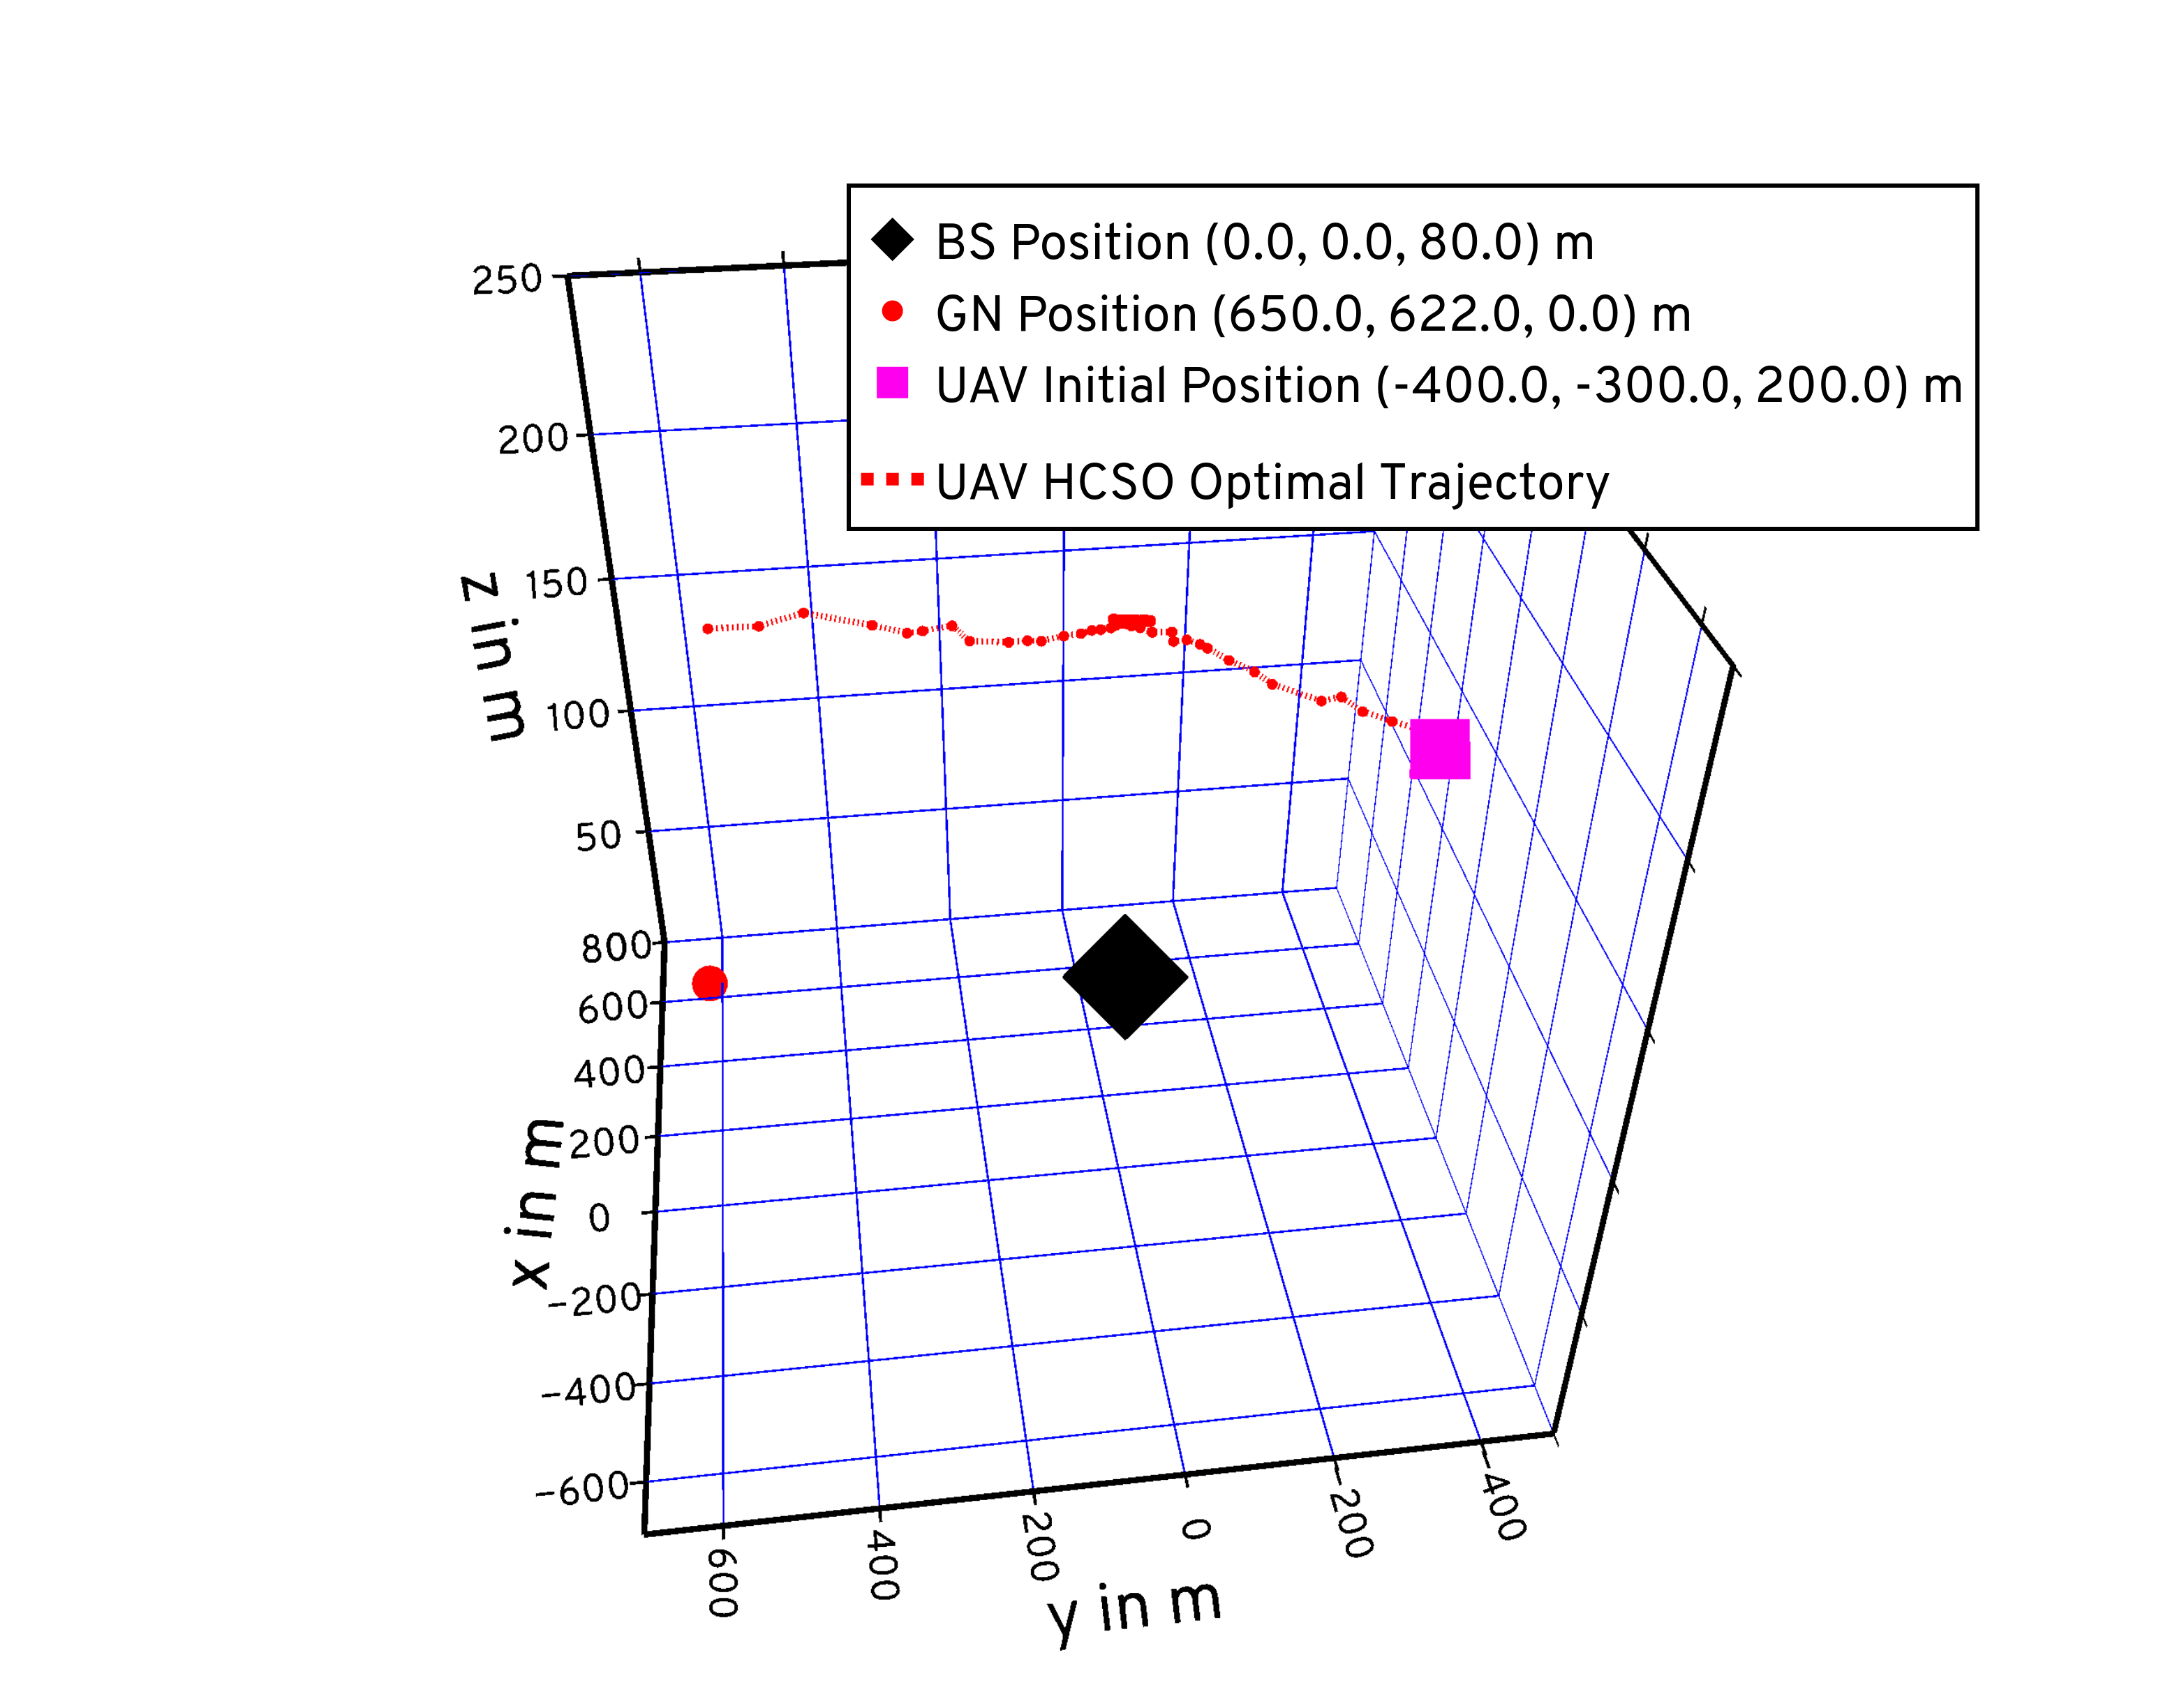
MAESTRO Trajectory Visualization: Execution to serve GN at (650, 622, 0) m

Slide 36
MAESTRO-X: eXtended MAESTRO
MAESTRO’s single-agent optimal policy is augmented with
Spread Maximization
Radial & angular movements of the UAVs in the waiting phase (CW/CCW)
Conflict Resolution
Scheduling decisions across the swarm in the request scheduling phase
Queue Management
M/G/x queuing models at the BS and the UAVs
Join Fastest Queue and Join Shortest Queue heuristics
BS-UAV and UAV-UAV coordination over a command & control network
Augmented policy is then replicated across the swarm enabling decoupled executions of a single trained policy

Slide 37
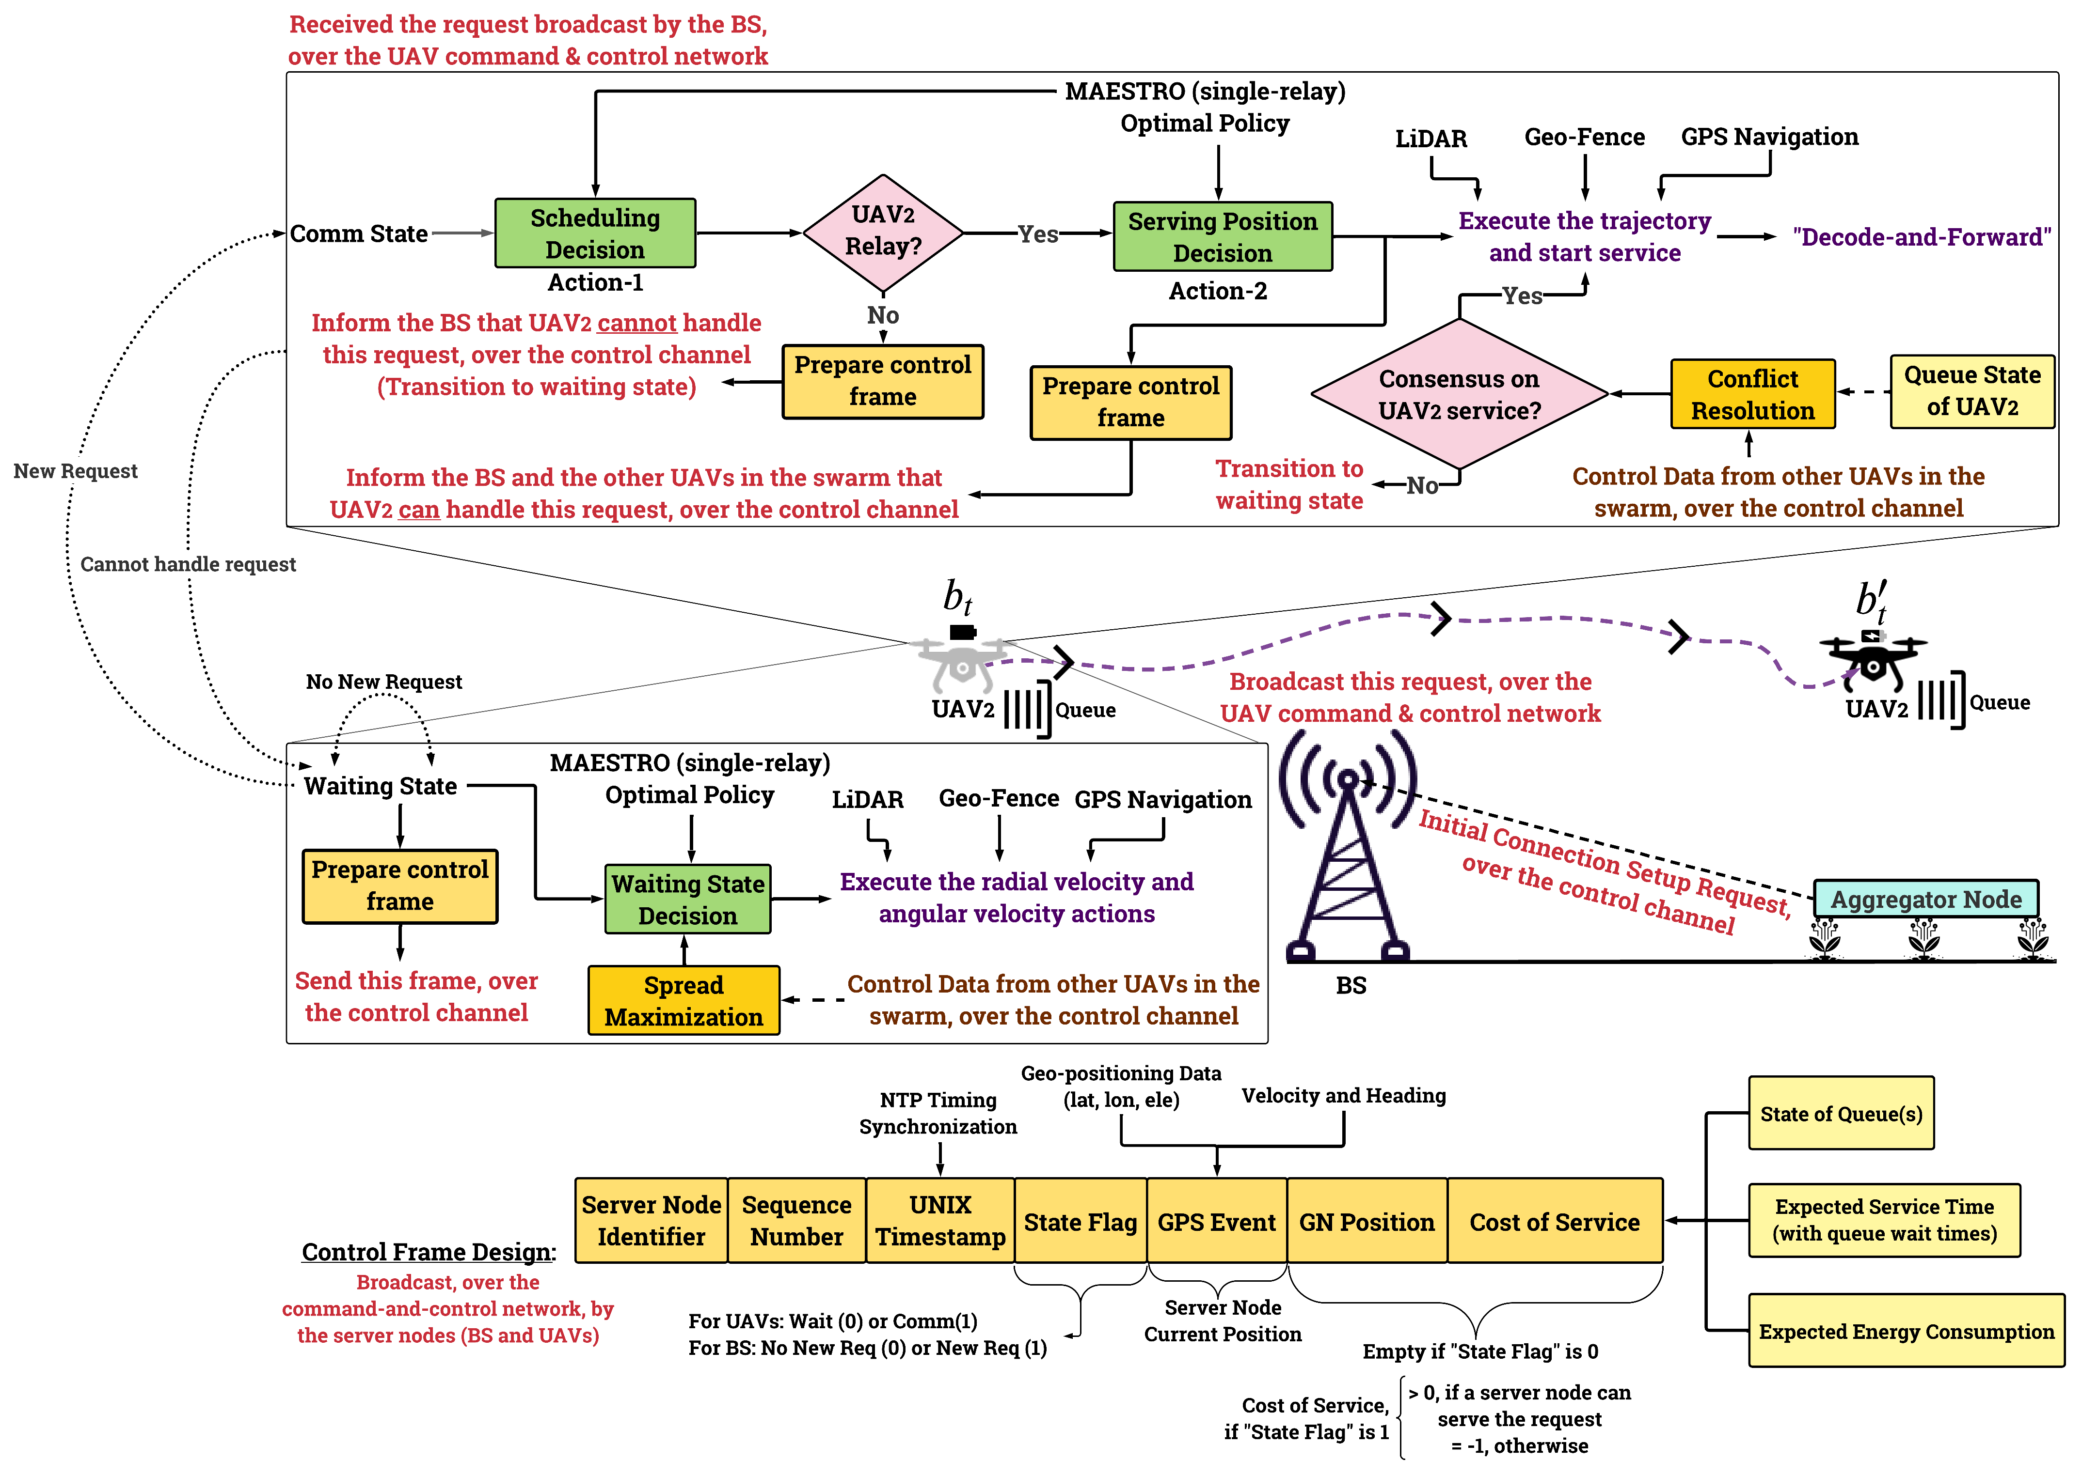
MAESTRO-X: Sample scenario analysis in precision agriculture

Slide 38
MAESTRO-X: Sample scenario analysis in precision agriculture | Waiting

Slide 39
MAESTRO-X: Sample scenario analysis in precision agriculture | Request Handling

Slide 40
MAESTRO-X: Sample scenario analysis in precision agriculture

Slide 41
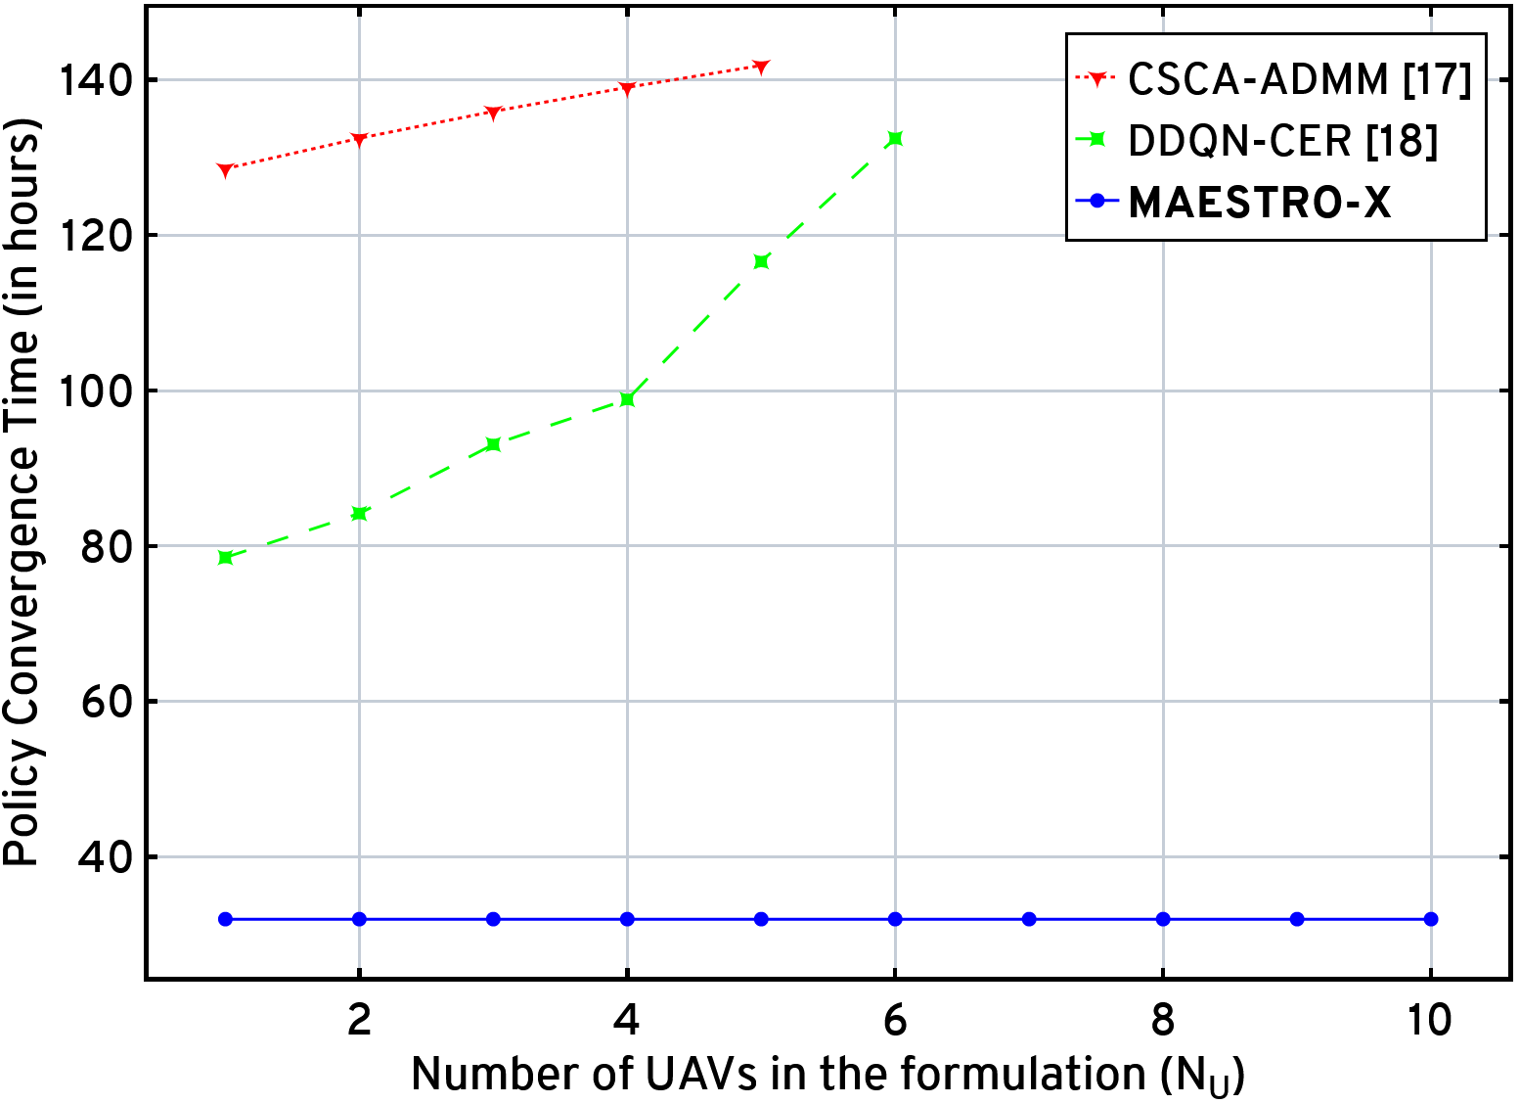
MAESTRO-X Computational Complexity Benchmarking against the state-of-the-art

Slide 42
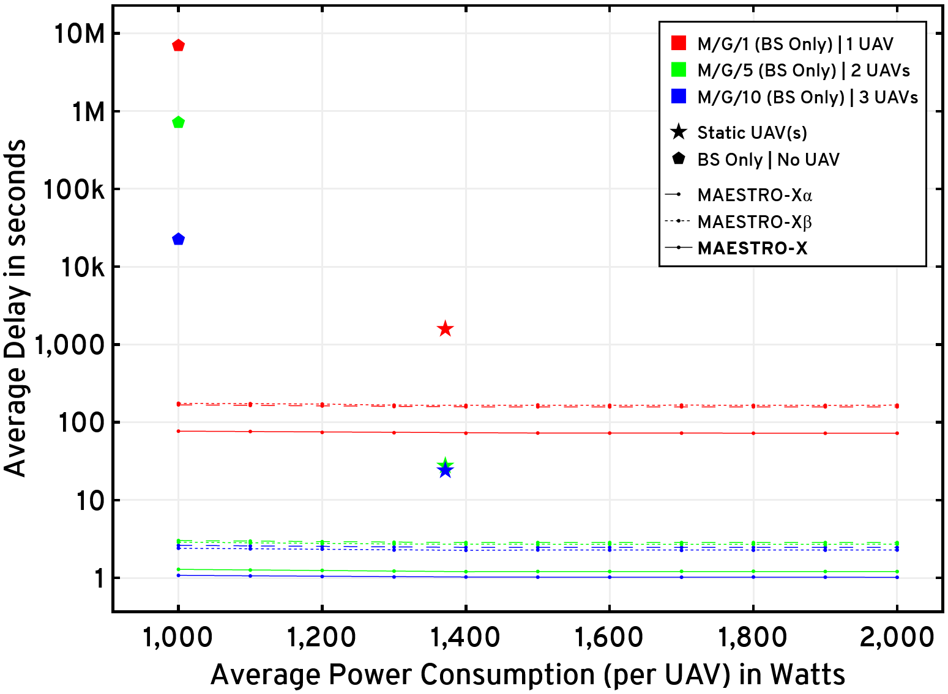
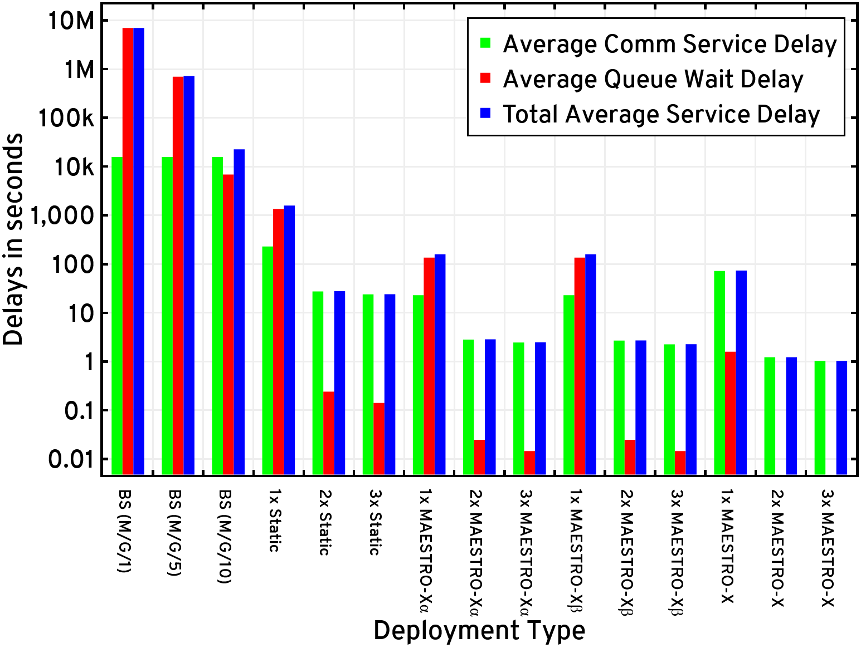
Average delay for the GNs versus per-UAV average power constraint
L = 100 Mb | MAESTRO-X Evaluations with various heuristics

Slide 43
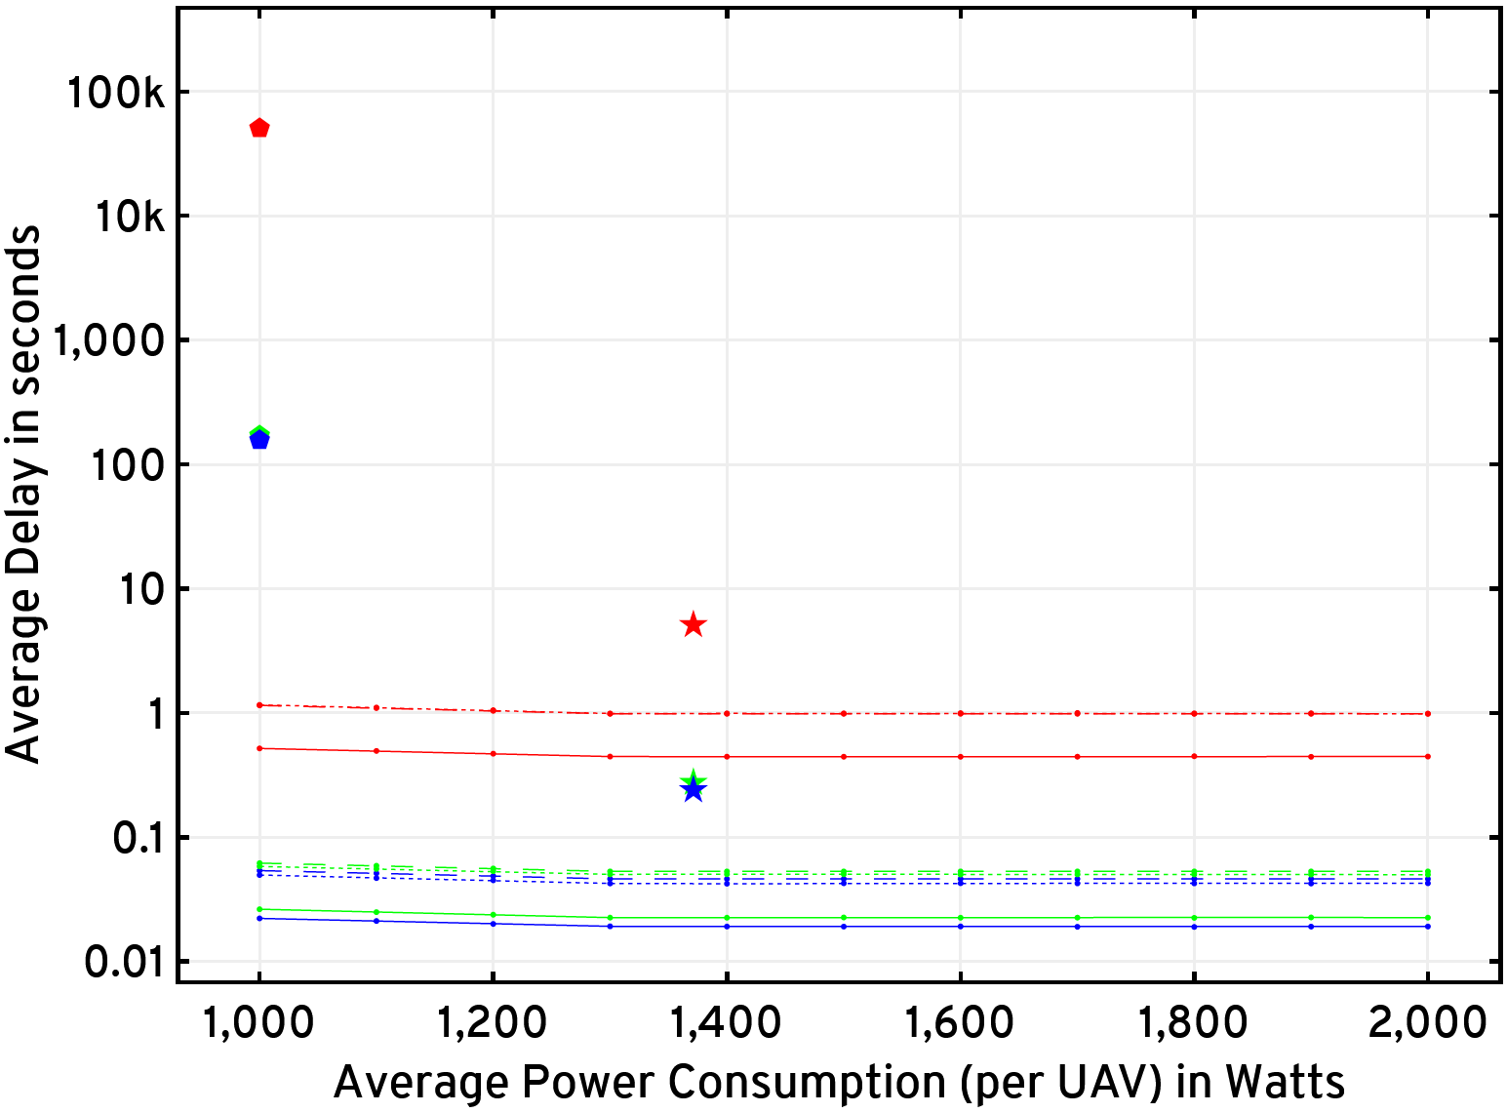
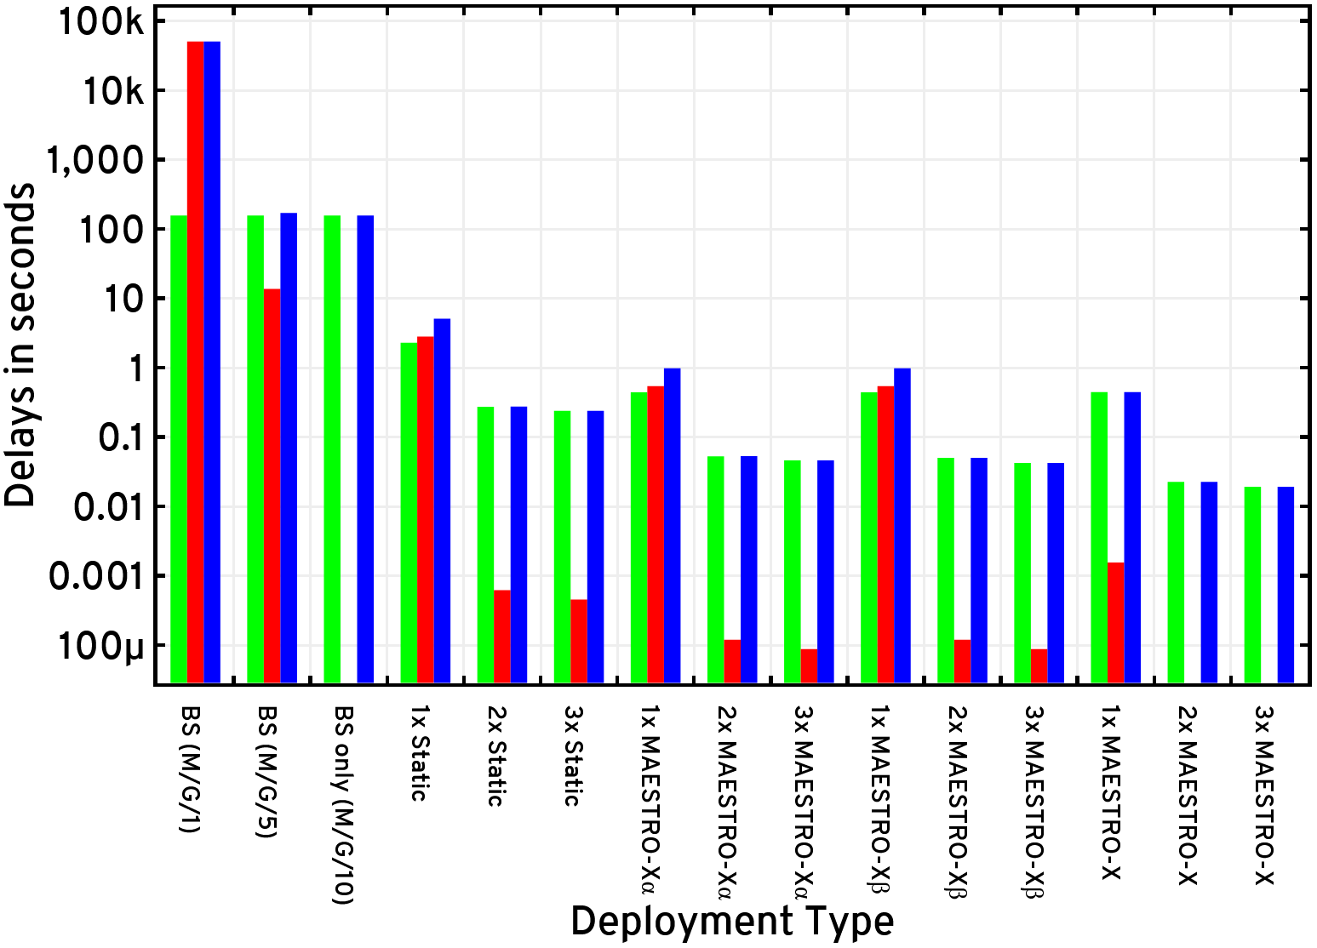
Average delay for the GNs versus per-UAV average power constraint
L = 1 Mb | MAESTRO-X Evaluations with various heuristics

Slide 44
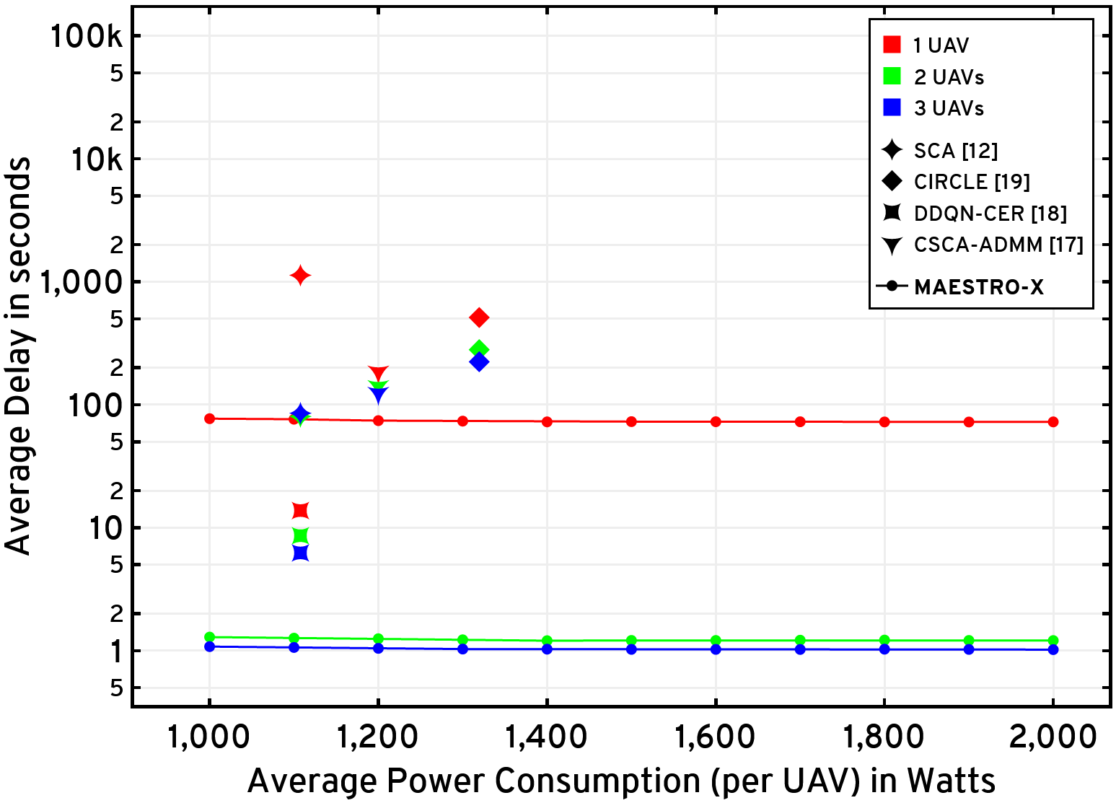
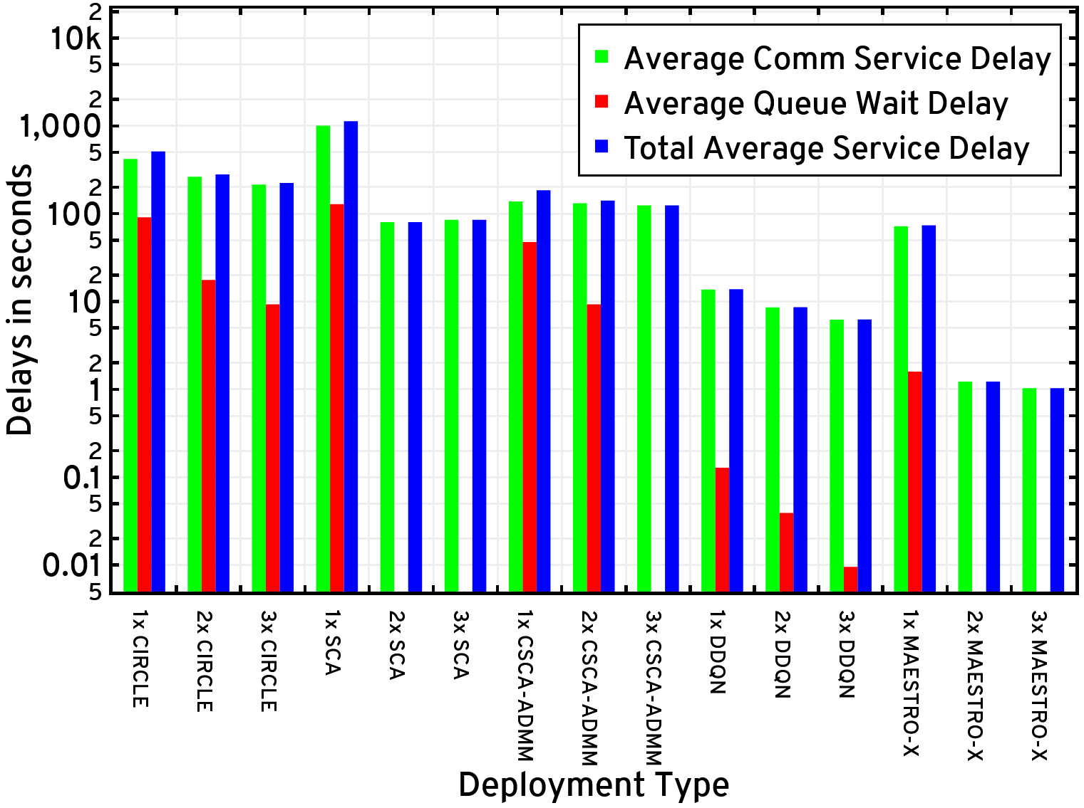
Average delay for the GNs versus per-UAV average power constraint
L = 100 Mb | MAESTRO-X Evaluations against the state-of-the-art

Slide 45
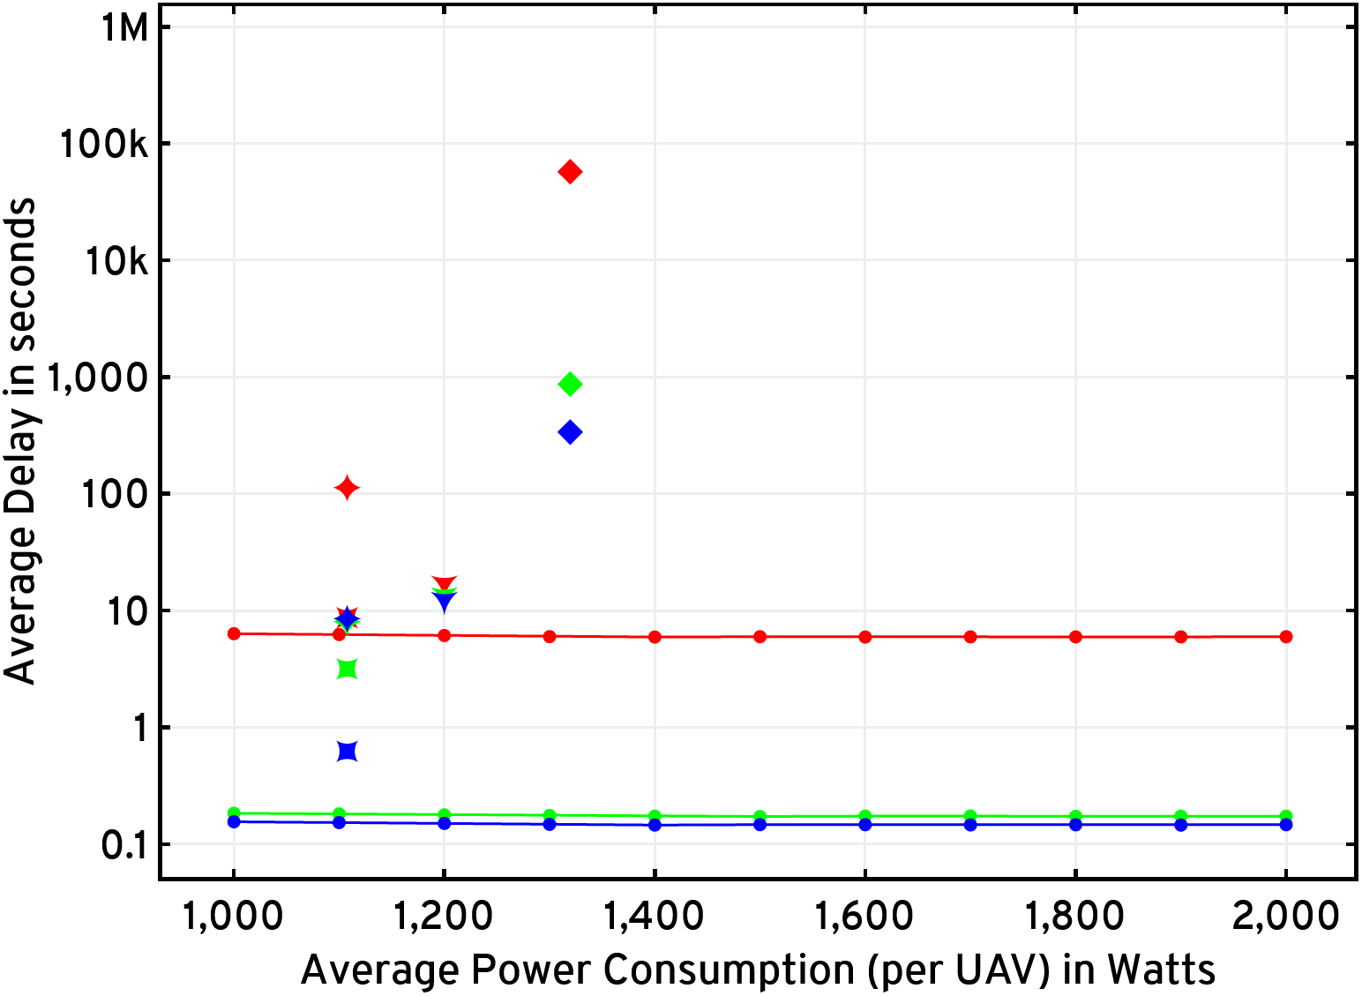
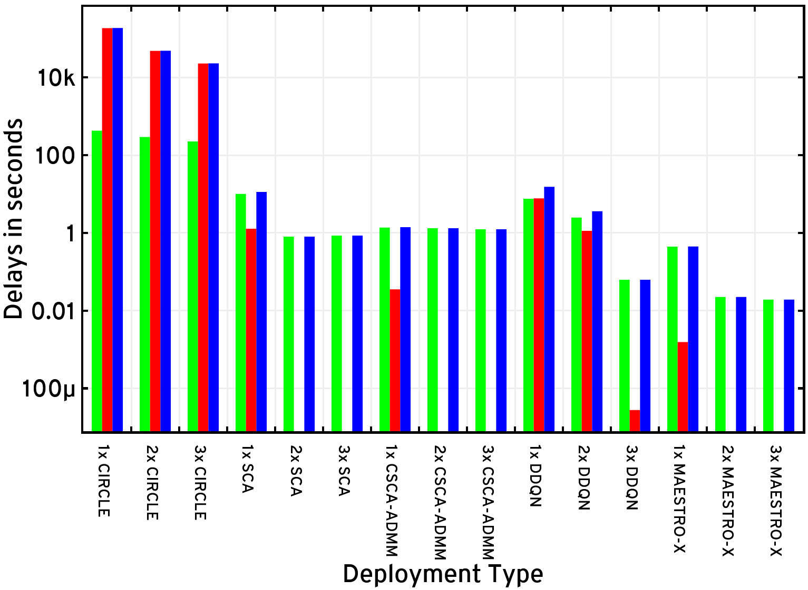
Average delay for the GNs versus per-UAV average power constraint
L = 1 Mb | MAESTRO-X Evaluations against the state-of-the-art

Slide 46
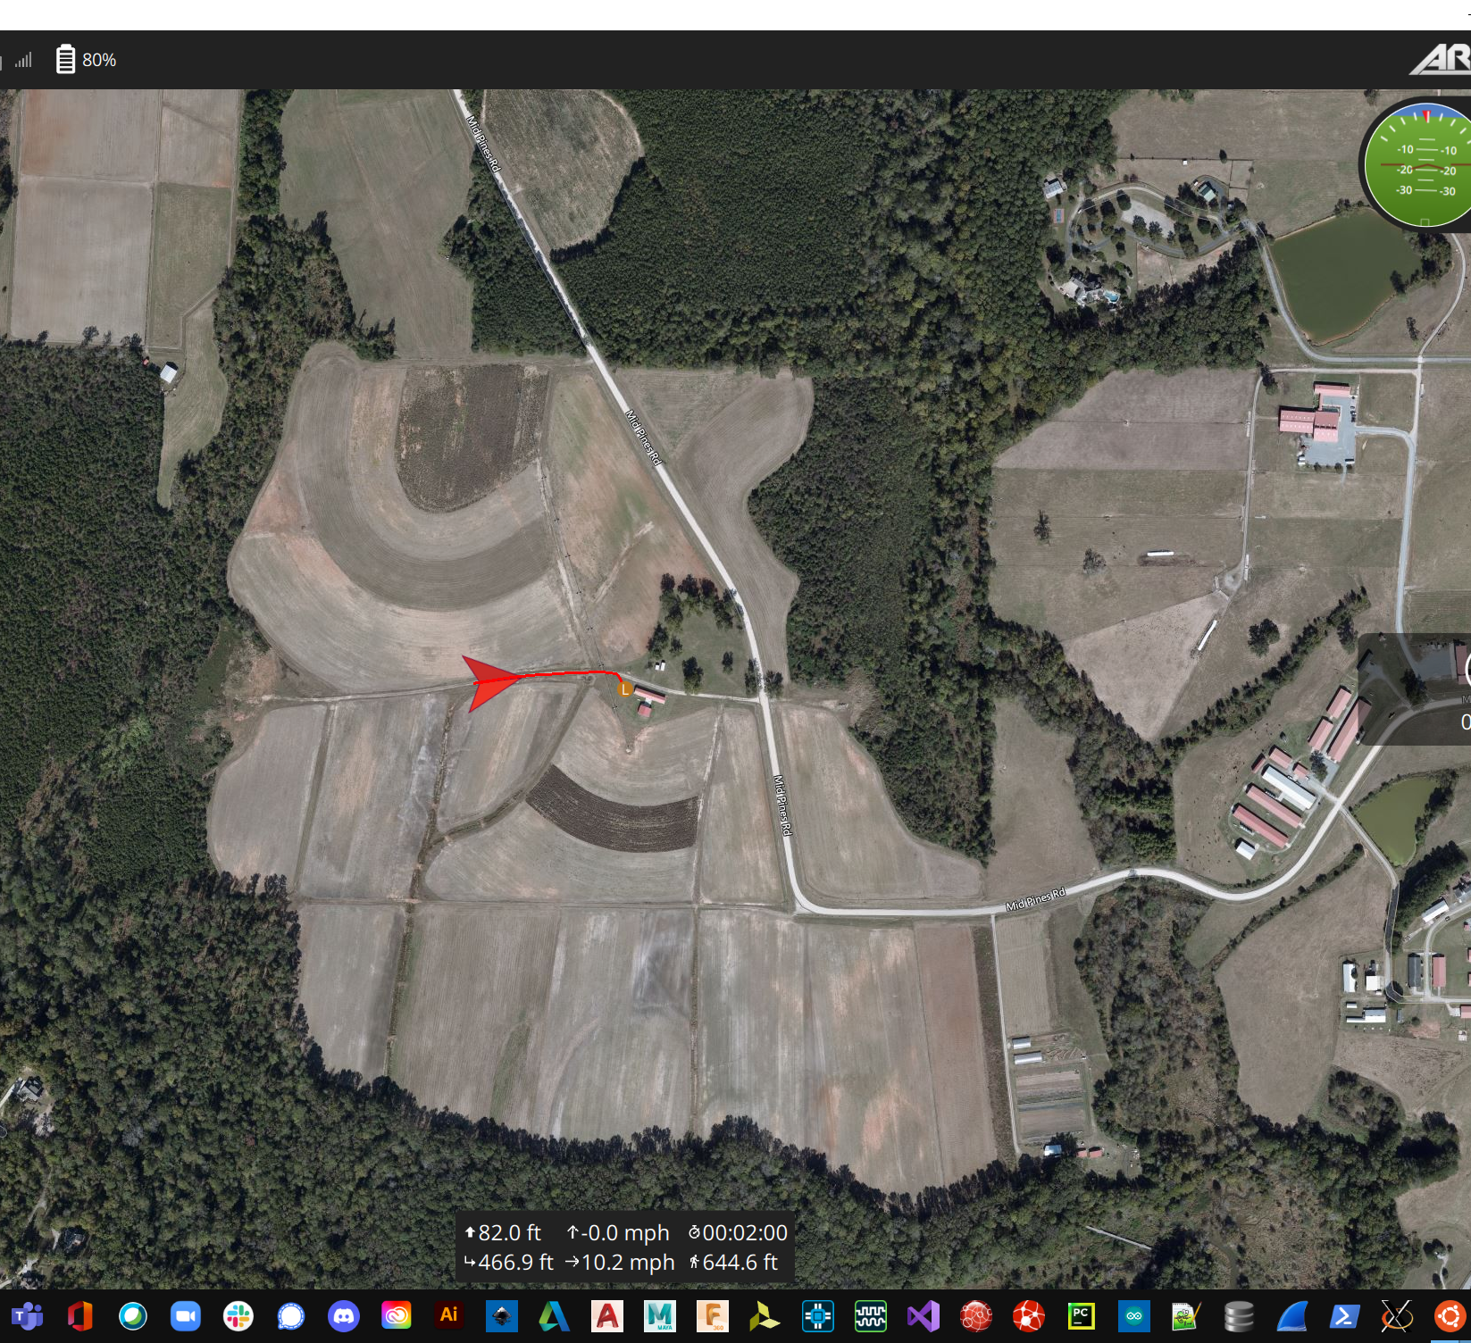
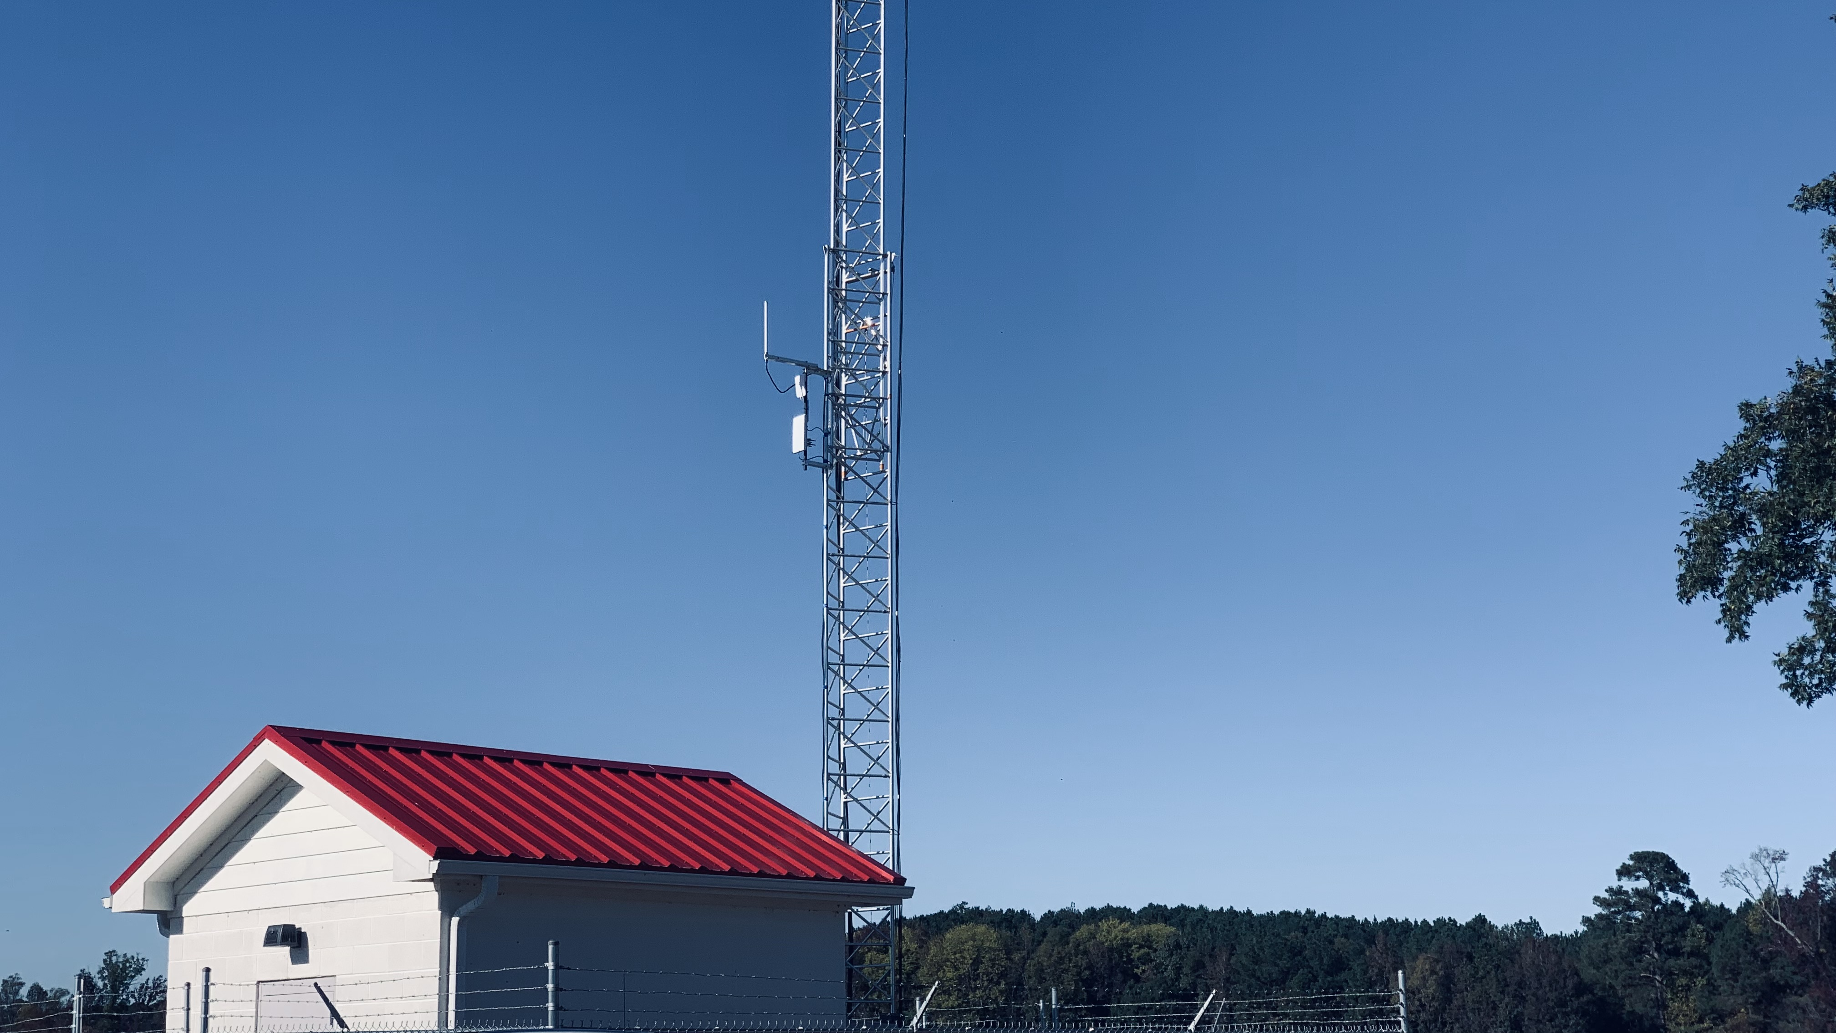
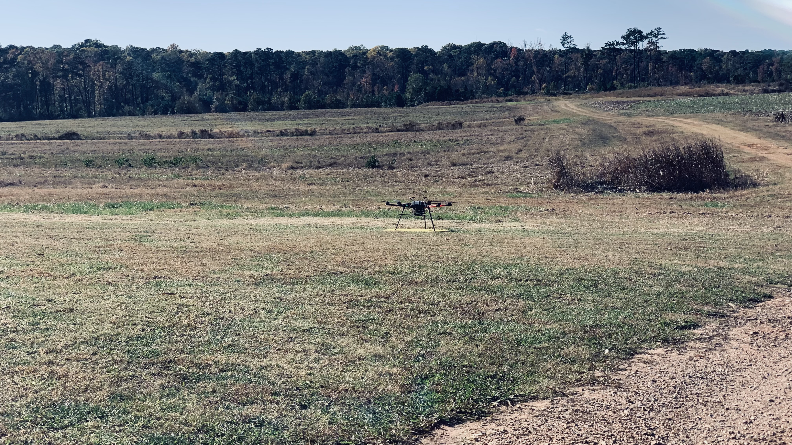
NSF AERPAW
Emulations & In-flight tests

Slide 47
Conclusion
MAESTRO-X: A framework for the decentralized orchestration of UAV relay swarms
The UAV relays augment the coverage and service capabilities of a terrestrial base station
Dynamic traffic from miscellaneous sets of randomly distributed ground users (UEs/IoT-sensors)
A2G channel model with rate-adaptation at all transmitters to maximize the system throughput
MAESTRO: Specialized to single-relay constructions:
Outer decisions on radial wait velocities and UAV service schedules & terminal service positions (SMDP value iteration)
Given outer decisions, inner decisions on angular wait velocities (exhaustive search) and UAV service trajectories (HCSO)
Supplement this policy with multi-UAV heuristics (spread maximization & conflict resolution) and replicate
Link Layer studies involving queuing dynamics and different queuing & scheduling variations
Performance comparisons with relevant schemes in the state-of-the-art as well as with policy-driven heuristics

Slide 48
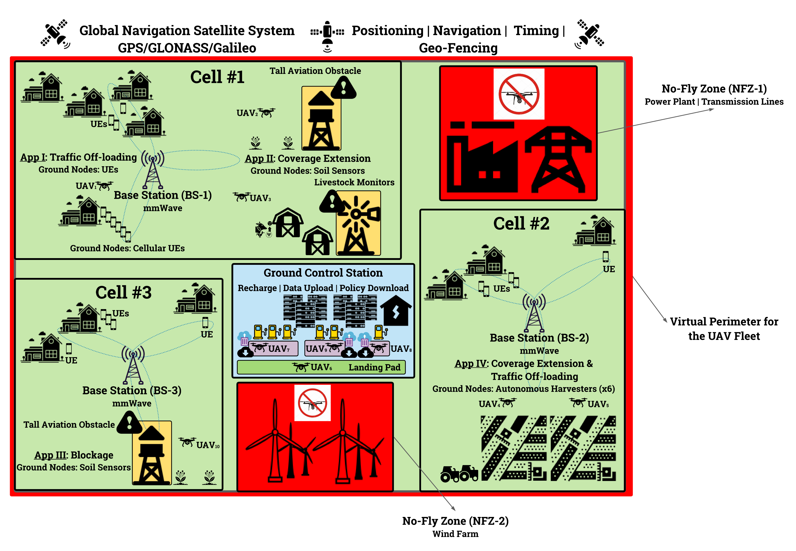
Future Work: System Architecture

Slide 49
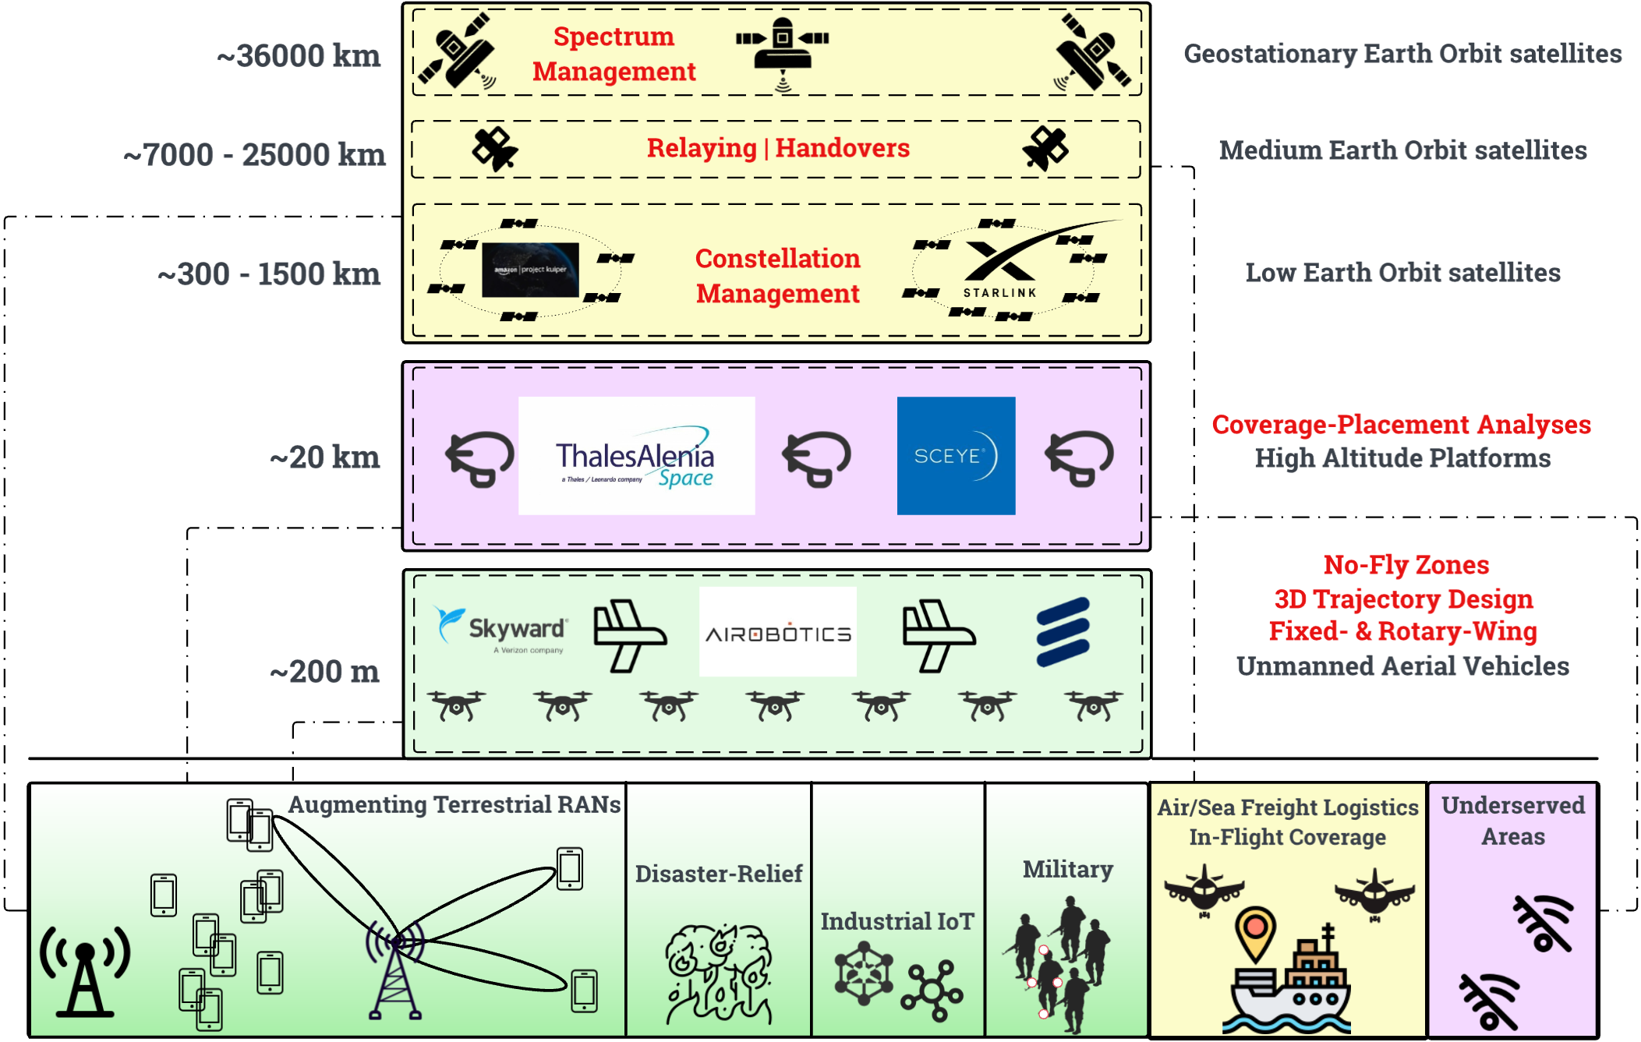
Future Work: Multi-Tier Application-Specific Vision

Slide 50
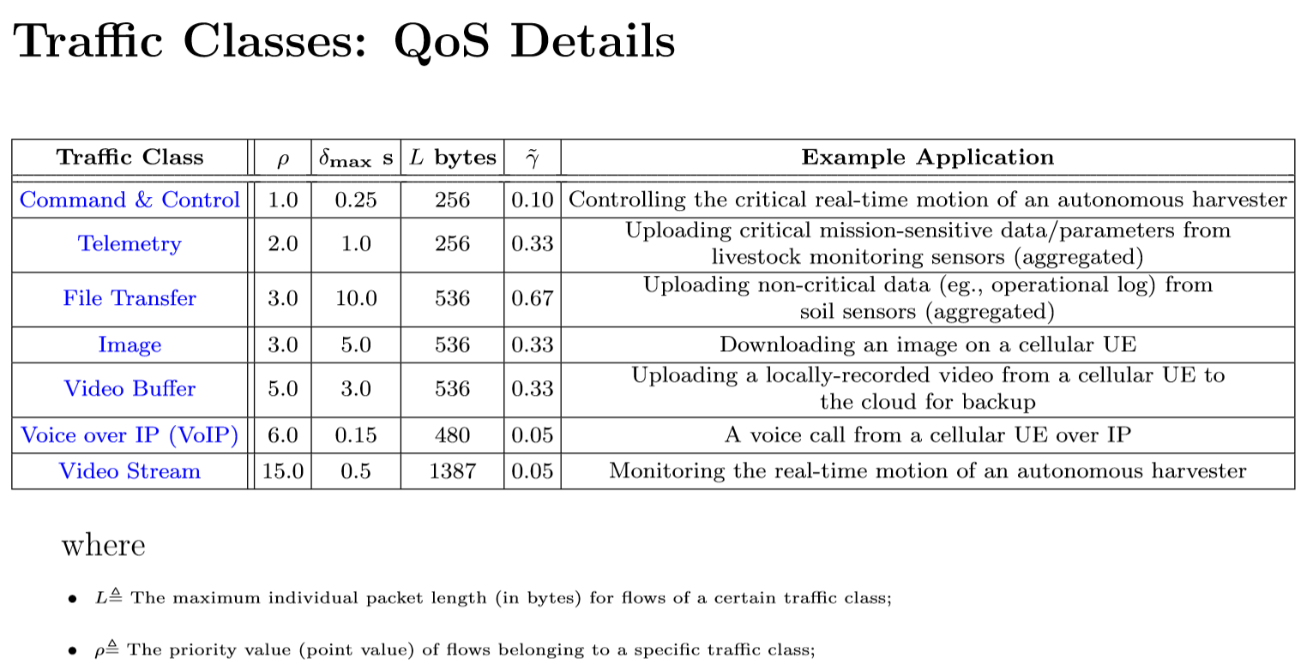
Future Work: Traffic Classes or Prioritized Network Flows

Slide 51
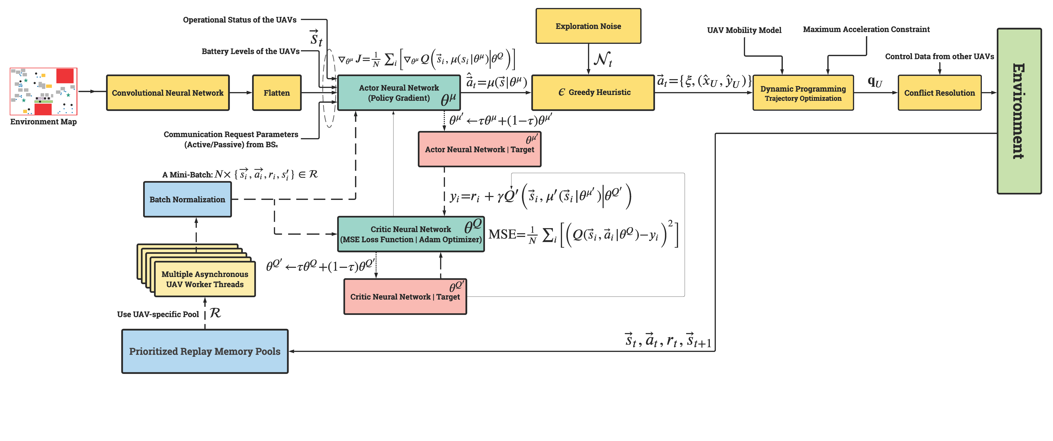
Future Work: Deep RL Architecture for Distributed Swarm Orchestration

Slide 52

Q&A

Slide 53
Thank you

